Slide 1

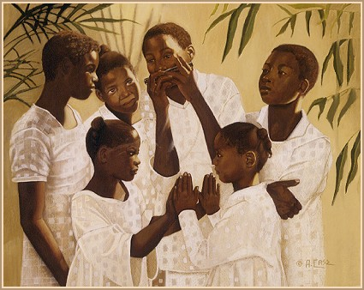

PALS
Presentation by
Monika Rhue, MLIS
Acting Director of Library Services
James B. Duke Memorial Library
Johnson C. Smith University

Slide 2
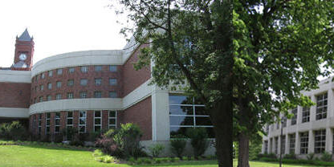
Introduction
James B. Duke Memorial Library was completed in September 1999.
The infrastructure of the new library was designed to accommodate changes brought about by the technological revolution .
The building is a state of the art facility with 56,553 square feet and seating for 430.

Slide 3
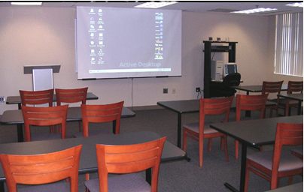
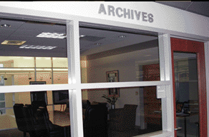
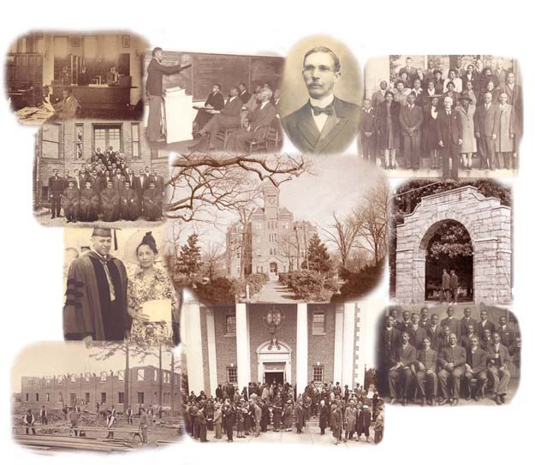
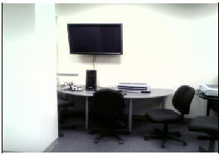
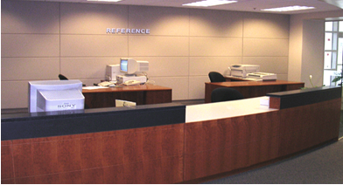
Introduction
The library has specialized features, including a Modern Communications Room for data/video projection, an Information Commons with cutting edge hardware and software to enhance presentations visually, an Information Literacy Classroom, a Curriculum Laboratory, and an accessible archives with a searchable database of over 8,000 digitized items .
http://archives.jcsu.edu/Library2/digidefault.htm

Slide 4

Introduction
On Paper It Looks Good, But

Slide 5
Introduction
Worthless, If No-One
Is Using Our Services

Slide 6

Objective
To introduce new strategies for Promoting Active Library Services in the James B. Duke Memorial Library.
To reach out to faculty and students by becoming proactive librarians, not waiting for our constituents to come to us.

Slide 7
Promoting
Active
Library
Services

Slide 8
Promotions
How current services can be promoted?
Network with Dean of Students Affairs, and Freshman Academy coordinators to find out what the library can do for them.
Present at the Faculty meeting. (Clickers).
Share results of meetings with library staff for feedback.
Invite the New Vice President of Academic Affairs to library staff meeting.

Slide 9
Promotions
How current services can be promoted?
Follow-up and implement VP’s vision immediately.
Find out/Get the librarians to buy into PALS.

Slide 10

Promotions
Surprise , the Vice President Vision was the same as Library vision.

Slide 11
Promotions
Sadly, not all librarians got on board!

Slide 12
Promotions
The Show Must Go On!
PALS was Launched

Slide 13
PALS Program
Freshman Academy
Reference To-GO
Programs & Services
Technology Web 2.0

Slide 14
PALS
Assigning each librarian to a Freshman Academy Cluster Leader for specialize services.
Freshman Academy

Slide 15
PALS
How To Avoid Plagiarism?
How To Search the Online Catalog?
What is Dreamweaver?
Writing Resources In the Library.
Importing Music and Special Effects using Power Point?
What is Snag-It?
Reference To Go Workshops

Slide 16
PALS
Mosaic Literary Book Club
Every 3rd Monday
Black Heritage Program
African American Studies Program
National Library Week
Film Series, Discussion & Entertainment
Purpose was to establish partnerships.
Bring the library into the social college culture.
Programs and Services

Slide 17
Promotions
Join the Web 2.0
Technology Revolution

Slide 18
Promotions
Key Points:
People want information quick and easy.
Libraries must be a part of technology by being creative and reinventing the way we deliver information to our constituents.
Librarians must evaluate and reconstruct our roles.
Librarians must think outside the walls and meet technology head-on by blogging, pod casting, and video casting .

Slide 19
Promotions
Digital Archives
Flickr-700 hits
eInformer-Sharing new books and resources electronically.
Clickers part of the Information Literacy-Interactive instruction
Coming Soon-Library Podcast & Interactive Tutorials.

Slide 20

Promotions

Slide 21
SUMMARY
My Stakeholders
How did I identify and involve my stakeholders?
What were the key changes/issues?
How were there managed?
What resistance did I encounter?
How did manage it and how did they respond?
Describe which goals were achieved?

Slide 22

The University Mission Statement
The Mission of the James B. Duke Memorial Library

