Slide 1
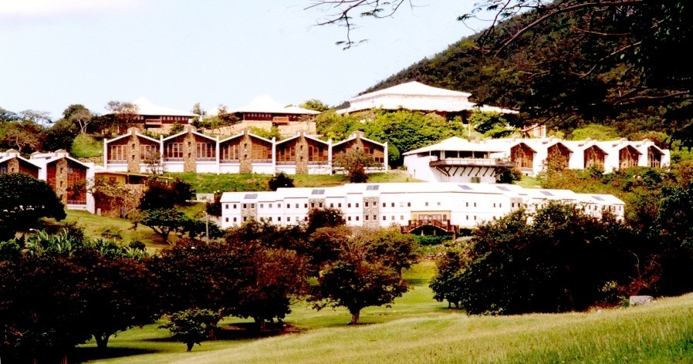
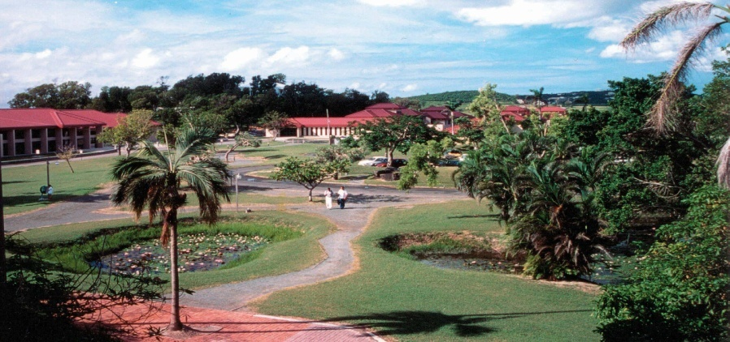
University of the Virgin Islands
“Calming the Storm”
Presented by:
Cherie Wheatley, Manager, Technology Customer Service
And
Celia Prince Richard, Librarian

Slide 2
OUTLINE
Abstract Summary
Introduction/Background
Goals of the Leadership Institute Project
Project Resources Needed
Uncovering the Immunity to Change Challenge
Recovery – Calming the Storm
Future Goals for Staff Development
Summary and Conclusion
Q & A

Slide 3
Abstract Summary
In this project, we saw examples of immunity to change lack of emotional intelligence and a need to develop leadership skills at all levels in the organization. This project focuses on all of these areas including an assessment of the level of satisfaction of both staff and customers.
Notes:
So in terms of satisfaction, it was satisfaction with the services offered in the unit/organization and with staff it was about the satisfaction with adapting to the changes and working relationship within the unit.

Slide 4
Beginning of the Storm Introduction
In 2005, technology and library resources merged into a single component called Information and Technology Services (ITS)
Improve services to constituents
Maximize resources
In 2008, ITS merged the circulation desk and the call center units.
Notes:
Information and Technology Services is a component of the University of the Virgin Islands established to provide information resources to meet the varying needs of the University community. In 2005, the University of the Virgin Islands committed to a reorganization of the technology and library resources into a single University component with the objective of improving service to our customers and maximizing resources.
We have five units. The Enterprise Network Services maintains accountability for the reliability of the network infrastructure . Enterprise Data & User Services is responsible for the development, implementation and management of enterprise wide application used at UVI. Library and Faculty Technology Services team advocate for faculty and incorporate technology in instruction. Library and Student Technology Services team advocate for student needs and manages the student learning environment. Lastly, the Customer Service Management team is responsible for ensuring high quality service to the customer and provides quality assurance across all areas of the ITS Division.
As part of its commitment to customer service and cross-functionality, in 2008 ITS offered a combined Service Desk at each campus library. Since ITS develops and promotes library and information technology services and resources, this combine service area provides a central point for the Component to serve its broad based of customers. The Service Desk is a single point of contact for students, faculty and staff.

Slide 5
Goals of the Leadership Institute Project
Assess the delivery of Customer Service in the Public Service area of the Information and Technology Service (ITS) Service Desk.
Focus on improving leadership in staff.
Provide training opportunities.
Assess staff acceptance of the newly formed merger of Library circulation desk and the IT call center.
Develop a process to recognize and make employees feel valued for their contribution to the success of the component.
Notes:
The call center as it existed as an entity was on St. Thomas. So the challenges that came up about the merger between the physical call center and the physical circulation desk had to do with St. Thomas. Yes there are certainly concerns with the staff on St. Croix with the overall merger and the changes that came about as a result of the broader merger of units. The attempt to investigate the issues related to the call center merger and the circ desk merger (those physical units) was located on St. Thomas. Certainly going forward , we should look at assessing the overall feeling and that assessment would not be just for St. Croix public service staff, but throughout the component as well.

Slide 6
Project resources needed
Hired consultant to assess staff satisfaction with changes in work requirements.
Provide training opportunities for staff in circulation & technology.
Training for emotional intelligence.
Survey tool www.formdesk.com to assess customer satisfaction.
Notes:
Funding to pay for training.

Slide 7
Uncovering the Immunity to Change
One year after the merger individuals working at the desk were not happy with the merger.
As a result, we hired an outside consultant in Sept 09 to perform an audit of ITS Service Desk on St. Thomas campus.
The consultant interviewed each service desk employee on the St. Thomas campus to determine their conflicts with management and or the merger of the circulation and IT helpdesk functions.
Notes:
No leadership. Staff were not problem solvers, the Service Desk was without management.
One unresolved issues: The audit was not performed on the St. Campus.

Slide 8
Visible Commitment Issues (Behavioral)
Staff resistance to cross-functional organizational structure at the desk
Staff lacked the understanding of institutional priorities
Limited opportunities for building capacity of some service desk staff for resolving circulation or technology requests
Limited opportunities for overall staff development.
Notes:
Before we received the results of the audit, the management team were focusing on behavioral issues.
Limited opportunities at that time : no procedures or manuals explaining how the unit should function, Customer Management was a new role for the unit/ UVI. No policies or procedures existed for this combine unit had to create policies as situations arise.

Slide 9
Study Revealed Hidden Competing Commitments
Staff needed leadership and direction
Staff felt that management was distant, not accessible or connected to the Service Desk Staff
Staff needed an opportunity and forum to share ideas, problems and give their input in policies and procedures that affect their work at the service desk.
Staff needed to feel valued.
Notes:
The study results revealed the true IMMUNITY which was hidden at the time.

Slide 10
Calming the Storm
Customer Service Manager
implemented leadership principles from the HBCU institute into her management style.
Service Desk working group was implemented.
Engage staff with team building activities.
Identifying the appropriate level of staffing based on demand peaks throughout the day.
Provided training opportunities for staff
Notes:
the Customer Service Manager had to incorporated into leadership behavior Emotional Intelligence, Self awareness, Social-awareness, self-management, break through leadership skills
Service Desk working group was developed with the intentions of creating a forum for the individuals that worked at the service desk. This allow them to have input in policy and procedure development.
Team activities including performance objective parties, created red card green card system for recognizing good/bad behavior from Management. Mangers and some staff read the book the five dysfunctions of a team. This system advocates using GHOST methods in resolving conflict in organizations.
Guide staff scheduling by using the data collected in the assessment activity which counts the number of customers that walk up or call into the ITS Service Desk each hour it is open.
We trained staff in technology solutions provided a technology knowledge base, develop a procedural handbook for the ITS Service Desk, training was conducted on circulation, use of technical equipment, we standard beginning of the semester processes, we standardize the resetting of
passwords for all UVI systems , we installed digital signage monitors in strategic locations on both campuses. These monitors are used to disseminate information and provide updates to users on library & technology changes in service.

Slide 11
Empower mid-level supervisors to identify service barriers that may be resolved on the spot.
Mid-level Supervisors were not seeing themselves as a part of the management team. As a result, they were engaging and supporting the staff in their negative attitudes towards the management team.
Staff were rewarded through promotion, yearly staff retreat, and t-shirts, parties, hikes, etc.
Notes:
Recognizing the need to empower mid- management was critical in stopping problems at the Service Desk and addressing conflicts with staff before problems escalated.
All supervisors in the unit now attend a monthly meeting and are now accountable for completing mid-level management task design to demonstrate their leadership in the unit.
Discuss staff rewards.

Slide 12
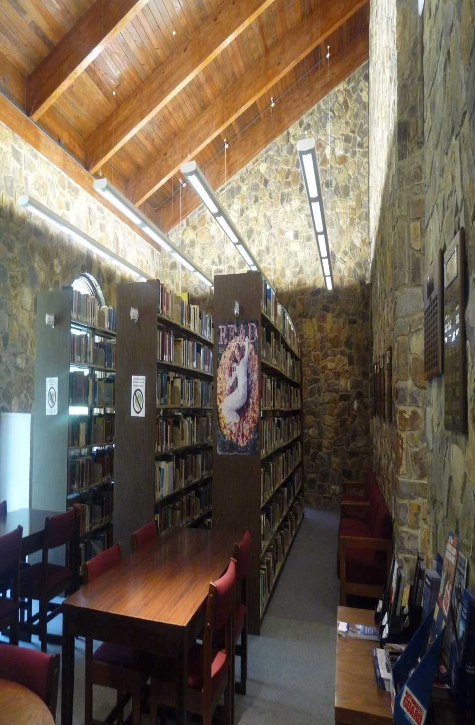
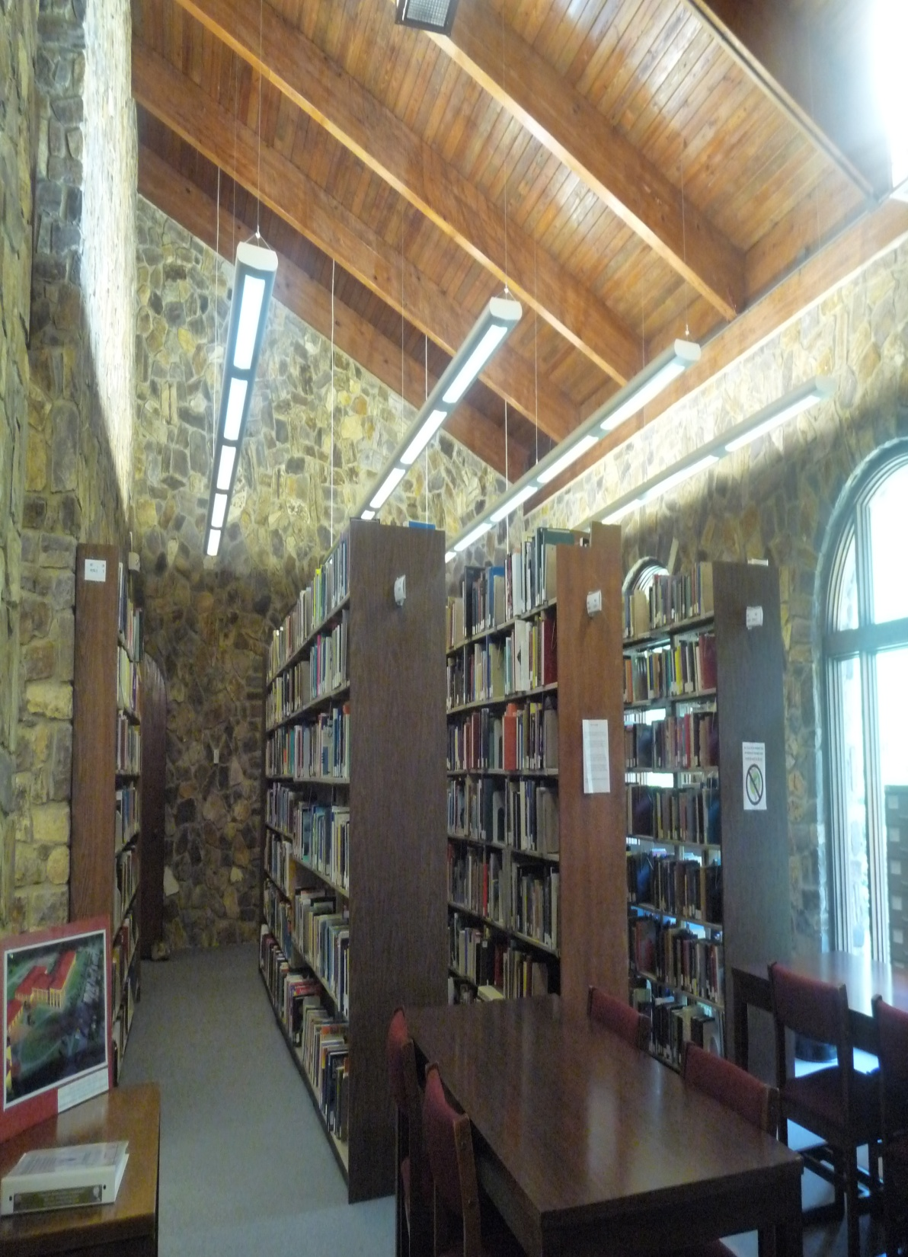
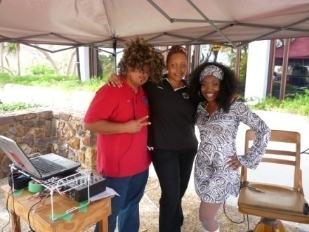
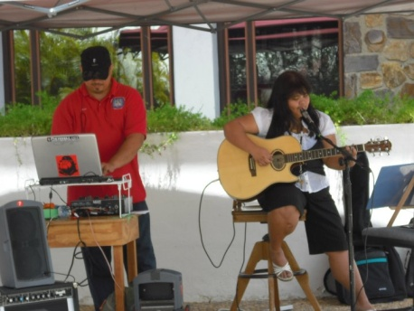
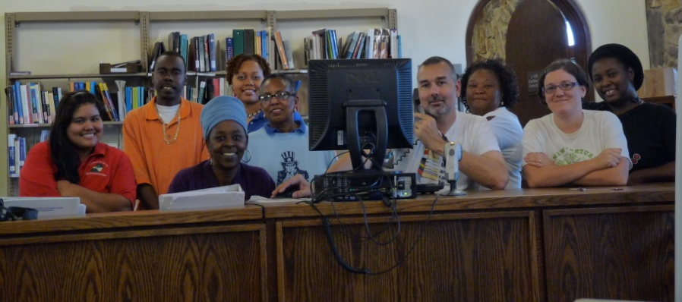
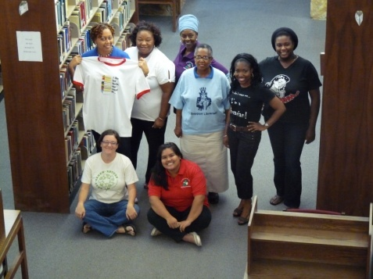
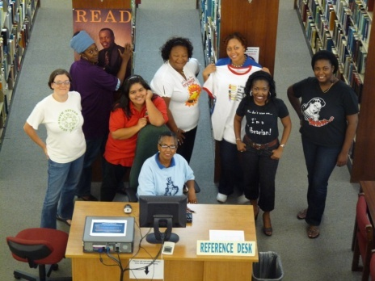
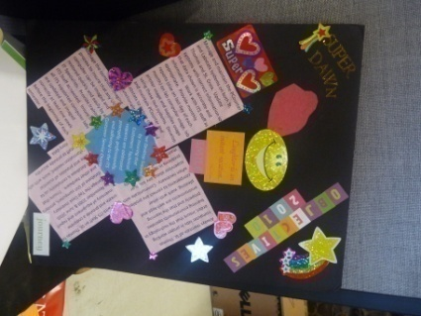
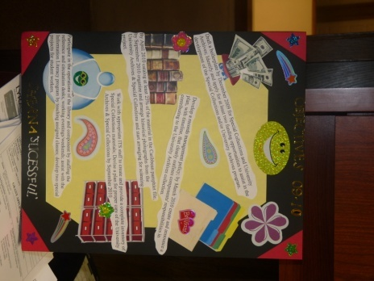
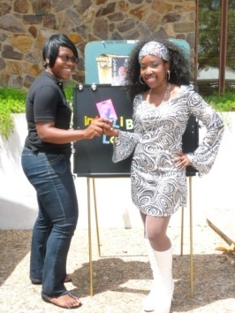
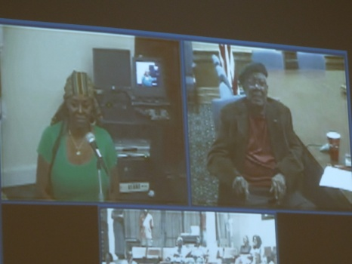
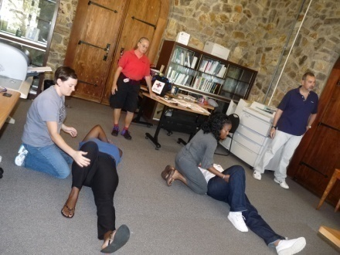
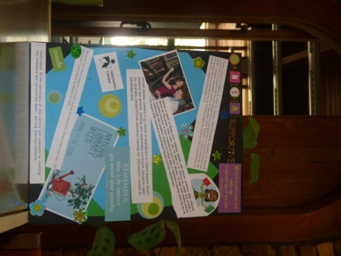
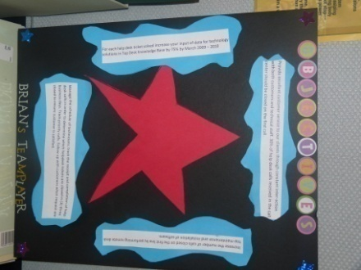
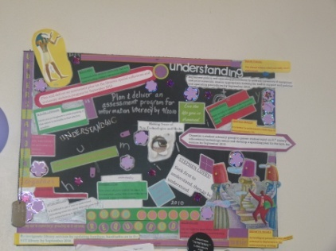
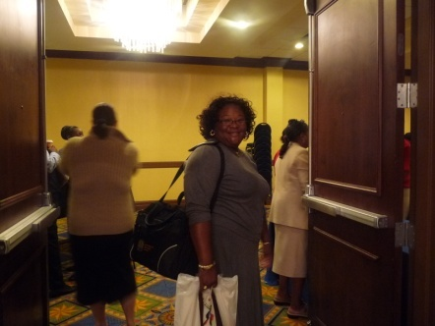
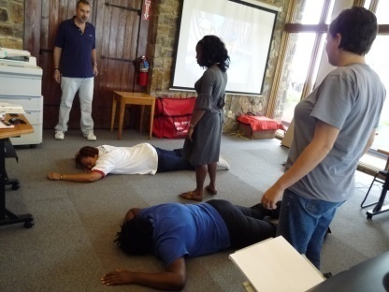
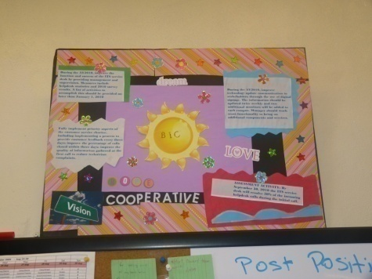
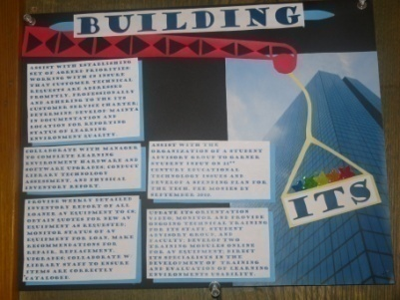
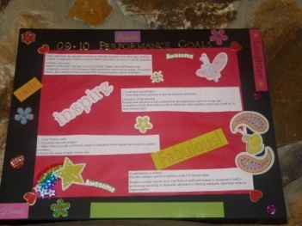
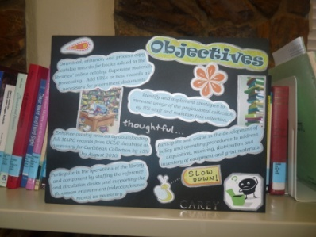
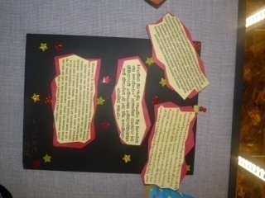
TEAM BUILDING

Slide 13
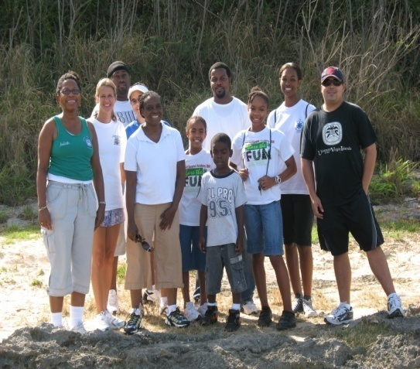
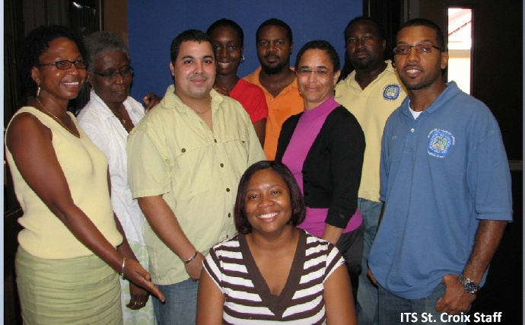
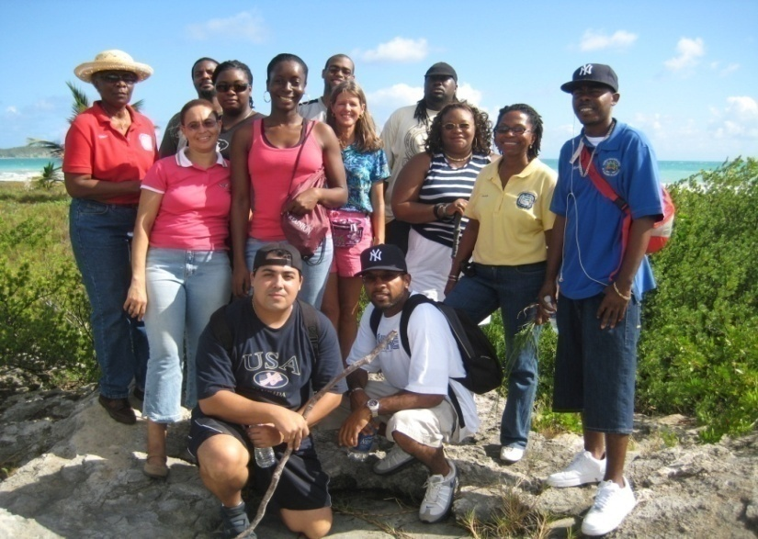
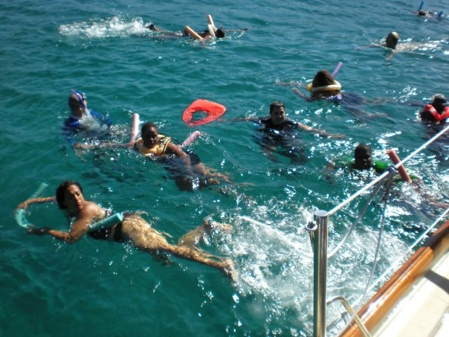
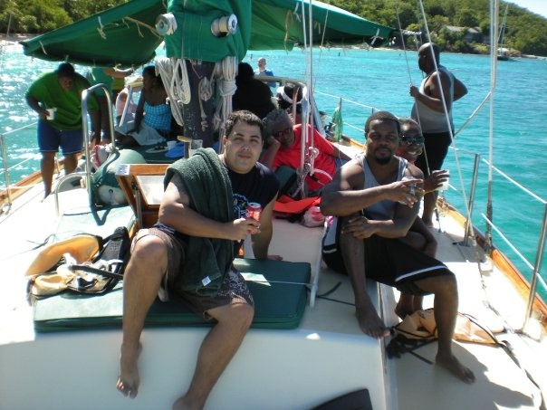
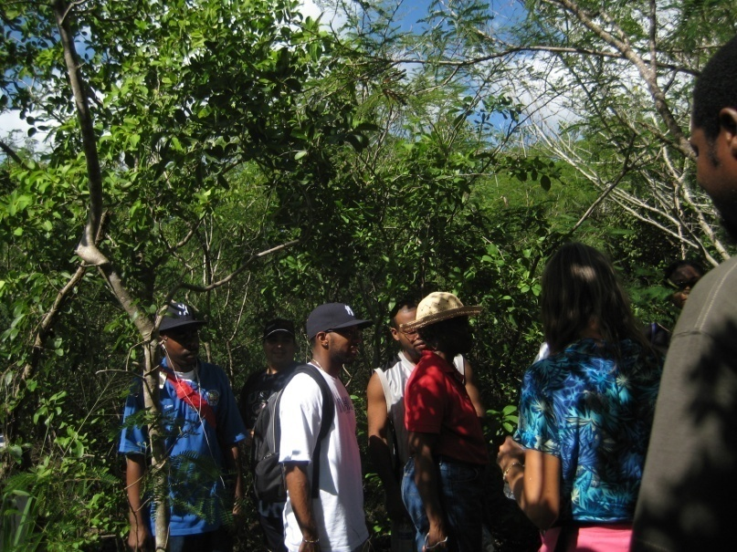
Fun Team
Activities

Slide 14
Future Goals for Staff Development
Continue to conduct customer service surveys and incorporate results to improve level of customer satisfaction.
Increase staff input in the decision making process
Develop policies and practices that make employees feel valued.
Notes:
Continue to seek feedback from our customers and integrate suggestions that will enhance service.
Maintain Supervisors and staff forums
Continue to seek new and exciting ways to make staff feel valued.

Slide 15
Summary and Conclusion
The 2010 customer service survey showed an improvement in customer satisfaction from 70% in 2009 to a 80% rating in 2010.
Managers engaged in developing leadership skills by reading and practicing the “Five Dysfunctions of a Team” by Patrick Lencioni.
Leadership is all about relationships and happens at all levels in organizations.

Slide 16
Leadership is……….
Cooperating
Thank you
Commitment
Flexibility
Advocating
Honest
Accountable
Showing Appreciation
Listening
Sharing
Rewarding
Understanding

Slide 17
Ms. Wheatley has always demonstrated amazing talents. But what she could not do was translate those talents into leading others. This experience at the HBCU Leadership Institute has made it possible for her to understand what leadership is .. and what it isn’t. This is something she struggled with for a long time. She knew what she wanted leadership to be and she had to rearrange her thinking and actions to perform at the necessary level. As she progressed through the program and she worked through all of her issues, the changes in her ability as a leader happened like a light switch. I could tell when she finally had all of the pieces put together. Her next challenges – like for all of us – is continuing to practice the new skills she has and make the best decisions every time. In that way she can ensure that she will continue to grow and build confidence and build success.
Tina Koopmans
Chief Information Officer
University of the Virgin Islands
St. Thomas, Virgin Islands
340-693-1460
tkoppma@uvi.edu

Slide 18
Staff Comments
Cherie Wheatley has shown an immense improvement in her leadership roll as the Customer Services Manager for the Information and Technology Services Department at the University of the Virgin Islands. She has improved her interpersonal skills by actively listening to the needs of her colleagues and providing swift solutions to the situation. Ms. Wheatley has transformed from a head-strong into a true leader and her demeanor is pleasant and genuine.
Sherna Gumbs
Librarian II, Special Collections & University Archives
Information and Technology Services
Ralph M. Paiewonsky Library
University of the Virgin Islands #2 John Brewer's Bay St.Thomas, Virgin Islands 00802-9990

Slide 19
Cherie Wheatley has improved her leadership skills. In the past, other staff members were intimidated by her strong personality and thought she was a bully. Over the past year Cherie has the changed the way that she approaches other staff members and the staff has really grown to value her leadership style. Staff sees her as a leader with whom you can express concerns and get them resolved. As the only customer service manager on campus she is setting example for other departments around campus and others are attempting to imitate her leadership style.
Dawn Matthew
IT Specialist II
University of the Virgin Islands

Slide 20
There have been several notable changes in the Cherie Wheatley’s leadership style over the past year. Ms. Wheatley is much more efficient at listening to and assisting with problems that may arise on the job. She is able to give constructive criticism in a form that is not offensive and allows me to fully understand her views. I am much happier to work with her today vs. last year and I feel much more confident in her leadership.
Christine S.L. Freeland
Library Specialist I
Life is a journey not a destination...enjoy the scenery

Slide 21
Staff Comments
Because we have a small staff, sometimes tasks are floating around looking for a leader. I believe that the leadership training is helping Celia recognize when to be proactive and step up to the leadership role, rather than waiting to have the role thrust upon her. This is a significant contribution to the organization as there are always multiple simultaneous projects requiring high level support for effective management. Celia’s professional development is helping her fill this gap.
Judith V. Rogers
Manager, Learning Resources & Faculty Technology Support Information & Technology Services
Information and Technology Services
University of the Virgin Islands
RR01 Box 10,000
Kingshill VI 00850-9781

Slide 22
I have watched Celia Prince-Richard climb the professional ladder from a student assistant to her present position as a Librarian. She has always been conscientious in the performance of assigned tasks. However, there has been a noticeable development where Celia takes ownership of assignments going to great lengths to ensure a successful completion. She troubleshoots problems until the challenge is resolved, and does not hesitate in asking questions. Thou an introvert by nature, Celia have been demonstrating confidence in herself and her abilities. She has developed as a listener and uses information as a tool and not as something to be hoarded. Celia’s relationship with team members continues to improve as she interacts with colleagues and patrons.
Wenda Stephenson
Supervisor / Cataloger
University of the Virgin Islands
RR01 Box 10,000
Kingshill VI 00850-9781

Slide 23
Q & A
Thank you!

