Slide 1
DIGITIZING OAKWOOD’S ARCHIVES
OR MAYBE, JUST
LAYING THE FOUNDATION
Heather Rodriguez-James
Oakwood University
May 2010

Slide 2
WHAT WILL BE COVERED
Abstract
Why, what, & how?
Project Review
Stakeholders Commitment
Change Model
Insights
Unmet Goals
Digitization and Strategic Plan
Conclusion, or Beginning

Slide 3
Acknowledgements
HBCU Library Alliance: Sandra Phoenix, Etta Royster
Leadership Institute: Karyn Trader-Leigh, and Marsha Hughes-Rease
Ira Revels, Project Manager , HBCU-CUL Digitization Initiative

Slide 4
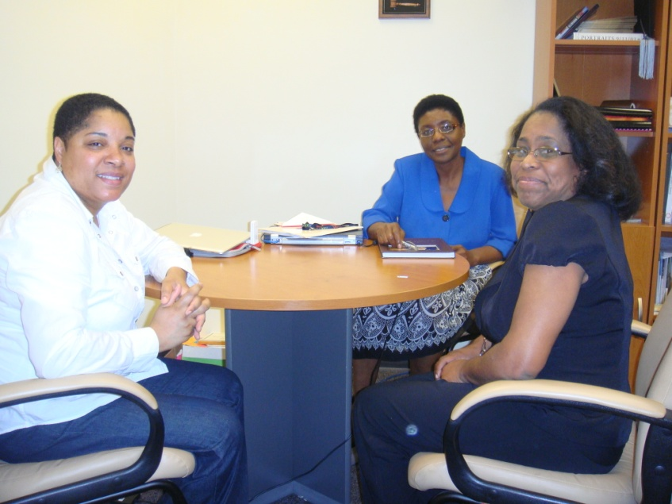
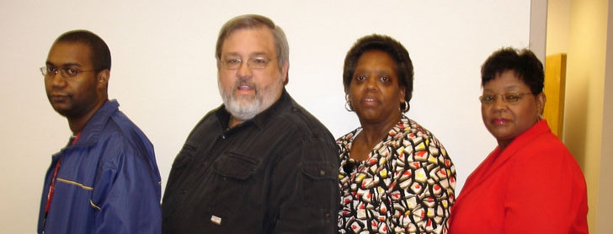
Acknowledgements
HBCU-CUL Digitization Init.
Tuskegee Team
Roderick Wheeler, Scanning Technician
Dana Chandler, Archivist
Margaret Alexander, Alumna
Juanita Roberts, Director & Mentor
Ira Revels, Project Manager
Paulette Johnson, Library Director, Oakwood
Heather Rodriguez-James, Student, Leadership Institute III

Slide 5
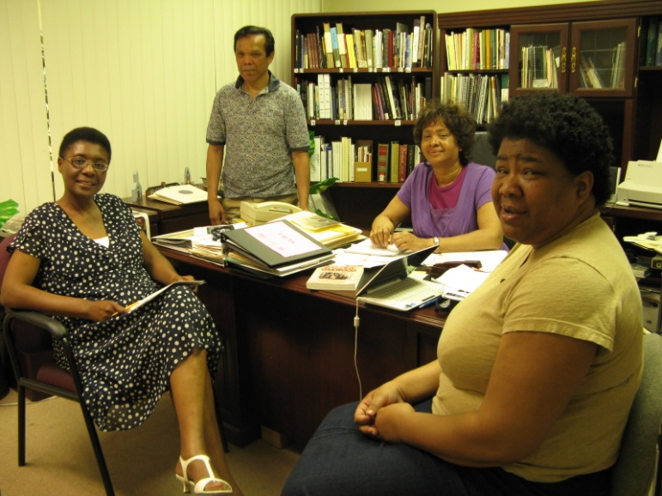
Oakwood Team
Paulette Johnson, Director
George Lee, Comp. Tech.
Joyce Williams, Archivist’s Asst.
Linda Rodriguez, Volunteer

Slide 6
Abstract Summary
A structure is put in place to ensure that the digitization of Oakwood’s Archives becomes a reality.
Notes:
This presentation looks at what is needed for the creation of a sound structure that will ensure the ongoing digitization of the Archives and Museum at Oakwood University. Under consideration are the tools, both human and mechanical; and the forms and policies that will be needed.

Slide 7
WHY? WHAT? & HOW?
Why should the library digitize its archives?
What needs would it satisfy?
What technical and staff resources are available?
How much time do people have to dedicate to this project? What are their skills?
What finances and technical resources are available?
Notes:
Reese, 2008, 6.
Digitizing the collection would provide wider access of the archival material, and assist with the material preservation.

Slide 8
Advantages
Improves desktop access to materials
Makes unique records widely available/accessible
More convenient than paper resources
No returns
Less damage
No shelf-space

Slide 9
Disadvantages
Technology is consistently changing
Data can be lost
Certain types of resources are dependent on specific hardware, software, or other networked resources
Staff may be more comfortable with traditional methods

Slide 10
Stakeholders
Stakeholders | Make | Help | Let | Q | O | Action
Archivist | X |  |  |  |  | Ensure Archivist knows the project leader is not usurping her position, but rather is concerned about clients having wider access.
Library Director | X |  |  |  |  | Keep communication open regarding needs (human and financial resources, hardware, and software) and progress.
Asst. to Archivist |  | X |  |  |  | Sold on project. Give encouragement and affirmation.
IT Tech. (Library) |  | X |  |  |  | Explain carefully what is needed; listen, and affirm
Library Staff |  |  | X |  |  | Sell the project to staff; keep them informed of progress

Slide 11
Stakeholders (cont’d)
Stakeholders | Make | Help | Let | Q | O | Action
University President |  | X |  |  |  | Already sold on digitizing historical photographs – see OU Goldmine, keep informed of progress
VP, Academic Affairs |  | X |  |  |  | Continue to keep him informed of progress
VP for Finance |  | X |  |  |  | Emphasize the importance of the digital collection to material preservation
Students, Faculty |  |  |  |  | X | Inform of project once implemented
SDA Community |  |  |  |  | X | Inform of project once implemented

Slide 12
Change Process
Preparation – Finding out about Digitization
Vision/Mission – What do we want to do?
Adjust requirements – Prioritize and break down into phases
Assess situation – Can it be done?
Plan the Implementation – Form Committee; present plan to admin.
Implement Phase I– Fall 2010
Assess to determine readiness for other phases
Assess change
Make adjustments

Slide 13
Helpful Insights
Self-evaluation tests (Strengths, DISC, and Emotional IQ)

Slide 14
Unmet Goals
Original plan to complete digitization of photographs in Museum not met.

Slide 15
Digitization & Oakwood’s Strategic Plan
Provide “access to information”

Slide 16
Conclusion -- Beginning
Oakwood now has :
Committed Administration
Firm plans to purchase equipment
Mentoring relationship with Tuskegee Library
Relationship with the Project Manager of HBCU-CUL Digitization Initiative
Archives’ Accession form
Revised Gift form
Volunteer Scanning Staff
Notes:
Although the original plan to have Museum photographs was not met, we do have in place a structure that will continue after the presentation of this project.

Slide 17
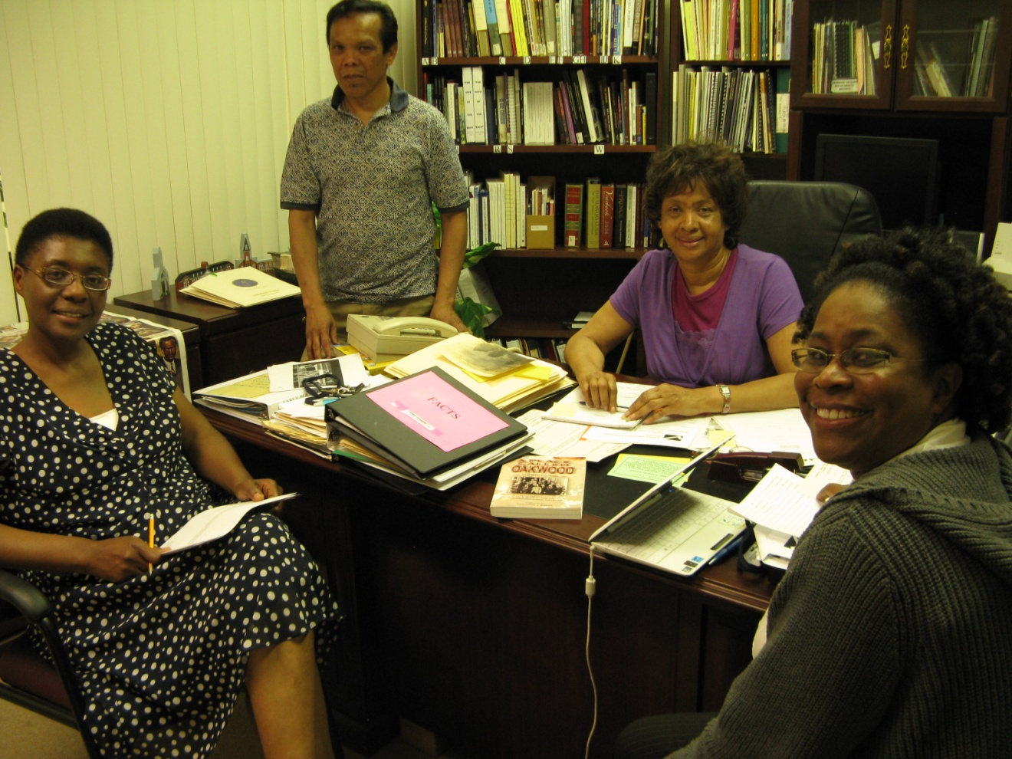
Library Digitization Committee
Notes:
Monthly Committee Meetings

Slide 18
Mission Statement & Goals
Acquire, preserve and make available, to Oakwood and the wider community, the rich history and legacy of Oakwood University and Black Adventism. The Digital Collection will include photographs, documents, recordings and various other materials with historical and genealogical relevance to Oakwood University and Black Adventism. It will draw images from the Archival collection, along with those provided by others.
Notes:
The mission of the Eva B. Dykes Digital Collection is to …

Slide 19
Goals
Provide the institution with a digital memory and a method to verify, refute or modify the recollection of its members and the outside community about the institutions and its constituents;
Preserve holdings by creating faithful reproduction thereby reducing handling of fragile and/or valuable materials

Slide 20
Goals (cont’d.)
Improve intellectual control (e.g., creation of an electronic finding aid linked to digital images and indexes linked to bibliographic records, and
Increase access and contribute to student learning outcomes.

Slide 21
Questions & Comments

Slide 22
Immunity to Change
Due June 4, 2010

Slide 23
Adaptive Leadership
Due June 4, 2010

