Slide 1
A SERVICE VISION: INFORMATION LITERACY
J C Oliver Library
Joyce Campbell, Director
Library/Media Services
Arkansas Baptist College
Little Rock, AR

Slide 2
ABC MISSION STATEMENT
Arkansas Baptist College is committed to the following purposes:
To show personal interest in every student with regard to scholarship and the development of character and personality.
To provide basic tools, communication skills, global perspectives and general education which are required in everyday contacts.
To provide a Christian philosophy of life with a frame for proper moral conduct. Arkansas Baptist College is committed to graduating students with an enhanced sense of community awareness and social responsibility.

Slide 3
MISSION STATEMENT
JC OLIVER LIBRARY
The library is dedicated to providing the highest standards in service and resources that support the College mission for excellence in learning, scholarship and service.
We are committed to creating an environment that’s reader-centered, book-centered and learning-centered with a distinct commitment to preparing students for leadership and service to our nation.

Slide 4
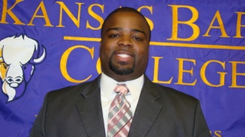
A VISION TO SERVE:
JC OLIVER LIBRARY
“Our vision is working interactively with faculty, staff and students to identify their information needs and to provide the resources and services needed in order to accomplish their learning and research objectives.

Slide 5
Goal - Information Literacy
To ensure that graduates of ABC are information literate; that students are able to identify information needs and use information appropriately in their academics, in a job-related context and as life-long learners.

Slide 6
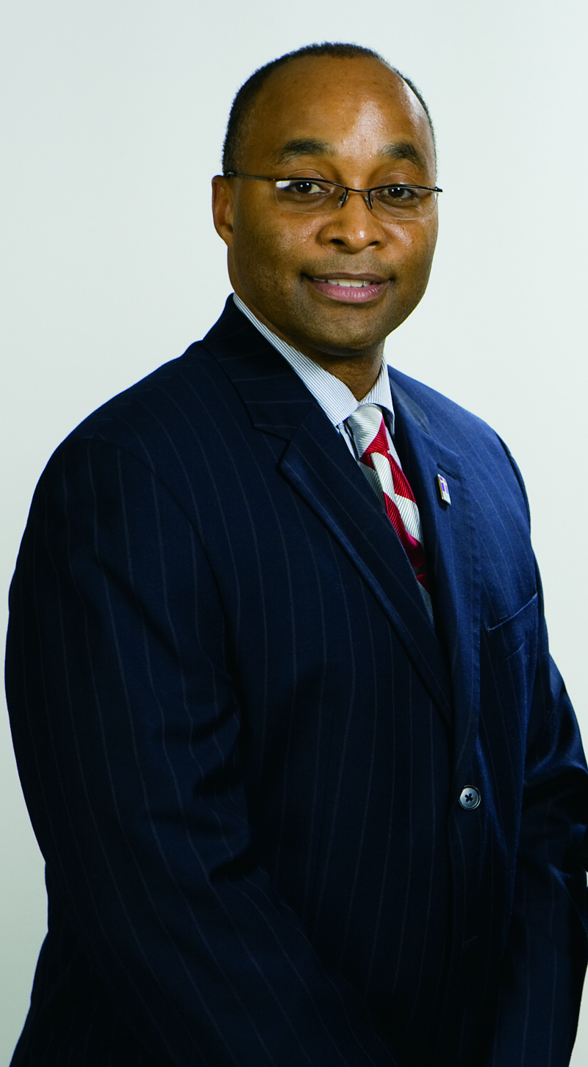
“Arkansas Baptist College has embraced its vision to grow, change, flourish and serve.”
President Fitzgerald Hill
What is our priority? To train young men and women to be leaders of character for their communities.
How will this be accomplished? By centering our academic efforts, programs and outreach on service.

Slide 7
Dr. James C. Oliver 10th President
Dr. Oliver assumed Presidency of the College in 1962. His life throughout his educational career had been one of service simply and honestly given. The tale concerning the old man who was building the bridge in the dusk of the evening, and when questioned about the care he took in building it, answered….“I do not build this for me, but for those young feet that will come after me, whose step is unsure, and whose way is not clear, I build it for them,” is indicative of the kind of man he was.

Slide 8
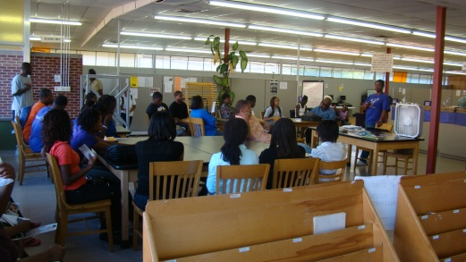
ABSTRACT
One of the key issues presented here is that information literacy is a fundamental requirement for a learning society. As a result Higher Education institutions need to implement information literacy education as a top-down initiative, where lifelong learning initiatives are promoted by institutional learning and teaching policies, and as a bottom-up approach to fully integrate these strategies in curricular activities that facilitate a dynamic investigation of the disciplines. (Andretta, 2005)

Slide 9
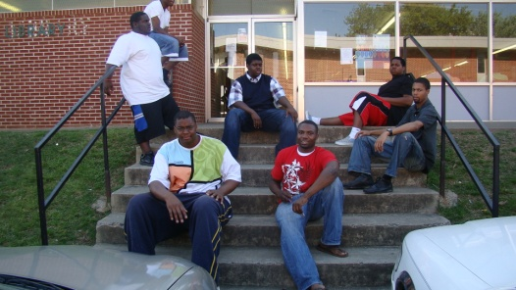
Information Literacy has become an element examined by academic accreditation teams in the United States. To be effective in our goal of graduating technologically adept students with effective research skills, ABC must integrate information literacy objectives into existing curricula.
The adoption of the following outcome goals will provide a tool to open dialogue between faculty, administrators and librarians towards this end.

Slide 10
INTRODUCTION
“Developing lifelong learners is central to the mission of higher education institutions. Information literacy forms the basis for lifelong learning.”
(ACRL, 2000)

Slide 11
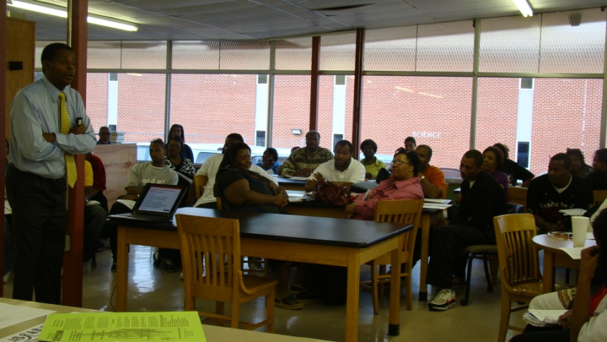
KEY ISSUES
Information Literacy
Why are we focused on it?
Information Skills
Interaction with Stakeholders
Program Implementation
Accountability & Assessment
What it is
Innovation
Competencies
List new traits that will be used to create your improved persona.
Goals/Outcomes
Participants
Challenges
Timeline
Performance Standards
Definition from ALA
Milestones
Accreditation
Service Development
Essential for success
Why now more than ever?
Evidence-Based Research
“Helping Students Master Information Literacy Skills”

Slide 12
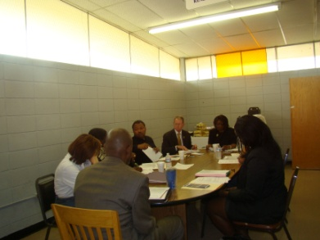
OUTCOME STATEMENTS
Identify information gaps or needs
Effectively find information using a wide
Critically evaluate information
Use information for problem solving and decision making in your academic, personal and professional life
The adoption of these goals will provide a tool to open dialogue between faculty, administrators and librarians towards this end.
“Libraries serve as a mechanism for making knowledge available.” (Lewis, 2005)

Slide 13
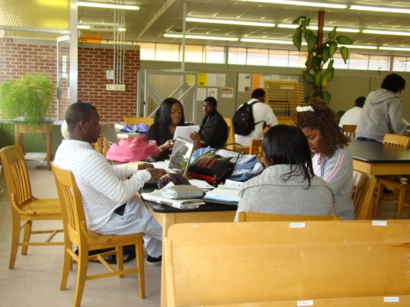
PARTICIPANTS
Faculty
Dr. Gordon Johnson
Maryam Estis
Janet Anokye
Edmund Davis
Benitez
Kendal Ashley
Neil Scoggins
Staff
Coretha Dillard
Kimberly Lockhart
Marcell Banks
Student
Rhinah Ondiso
Stakeholders
Dr Robert Houston
Dr. Willie Hardin
Dr. Howard Gibson
Janet Anokye
Dr. Gordon Johnson
Dr. Fitzgerald Hill*
Billy Owens*
Coretha Dillard
Charles Rodgers
Angela Bradford
Annie Abrams

Slide 14
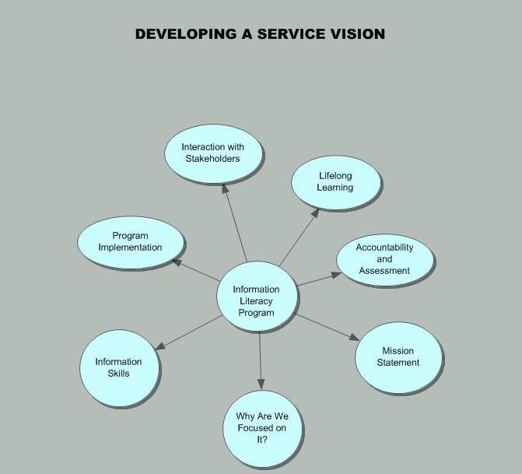

Slide 15
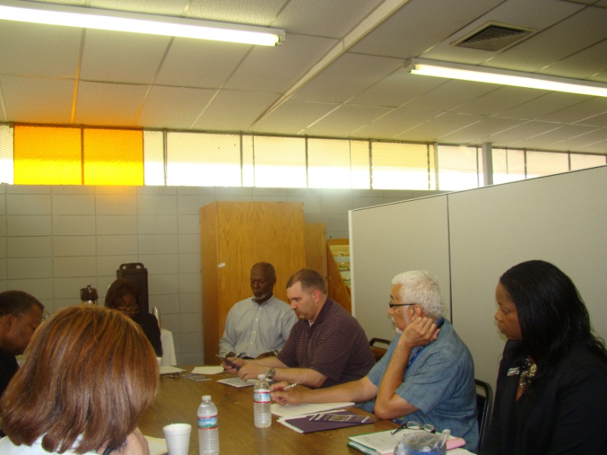
Challenges
Infrastructure
Implementation
Insufficient Staff
Space
Administrative Support
Process
Networking
Collaboration
Meetings
Interviews
Partnerships
Research
Library Committee

Slide 16
INSIGHT
“Great leadership comes from the inside out.”(Trader-Leigh, Rease, 2008)
I’ve learned that the initiation of an information literacy program is not just the responsibility of the library but has a wider remit for educational and social developments (Snavely, 2001).
It is therefore hoped that this special issue will be relevant to a wide readership consisting of educators in general, and not just those who actively promote information literacy education. One of the key issues presented here is that information literacy is a fundamental requirement for a learning society. As a result Higher Education institutions need to implement information literacy education as a top-down initiative, where lifelong learning initiatives are promoted by institutional learning and teaching policies, and as a bottom-up approach to fully integrate these strategies in curricular activities that facilitate a dynamic investigation of the disciplines. (Andretta, 2005)

Slide 17
CONCLUSION “Effective implementation of information literacy education, and particularly, the adoption of independent and lifelong learning goals, necessarily require a shift in the educational culture of Higher Education Institutions. With this shift comes the need for a new approach to teaching, and the consequent establishment of a collaborative relationship between library and faculty staff.” (Andretta, 2005)
“Information literacy is a key component of and contributor to lifelong learning.”

Slide 18
MY MENTOR: Dr. Theodosia T. Shields, Director Library Services & Assistant Professor North Carolina Central University Durham, North Carolina
THANK YOU…

Slide 19
SPECIAL THANKS: HBCU LIBRARY ALLIANCE SANDRA PHOENIX & E TTA ROYSTER HBCU LEADERSHIP INSTITUTE III KARYN TRADER-LEIGH MARSHA HUGHES REASE HBUC ON-LINE LEADERSHIP CAMPUS HBCU ADMINISTRATORS ARKANSAS BAPTIST COLLEGE ADMINISTRATION

