Slide 1
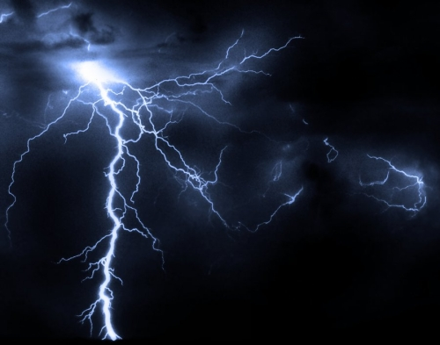
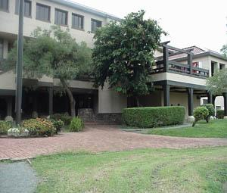
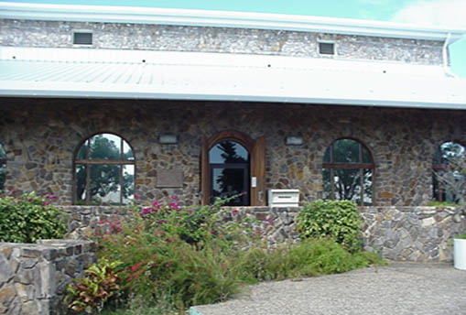
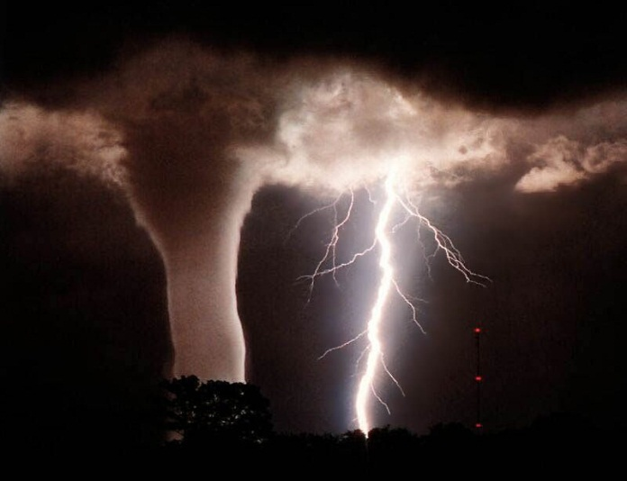
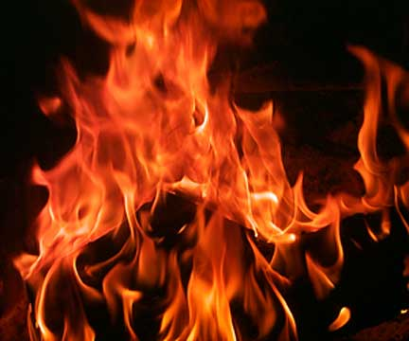
LIBRARY DISASTER PREPAREDNESS & RECOVERY PLAN
Presented by
Sherna Gumbs
Special Collections & University Archives Librarian

Slide 2
OUTLINE
Abstract Summary
Introduction/Background
Project Goals
Process
Challenges
Outcomes
Summary & Conclusion

Slide 3
ABSTRACT SUMMARY
The University of the Virgin Islands Libraries Disaster and Preparedness and Recovery Plan is a guide that provides procedures and instructions to library personnel for responding to emergencies involving its collections. It is designed for both the St. Thomas and St. Croix libraries to prevent and minimize damage to collections in the event of a disaster. The plan will address disasters that are unique to the territory specifically hurricanes.

Slide 4
INTRODUCTION
The University of the Virgin Islands libraries are designed primarily to support the academic programs of the University.
UVI is a Historically Black Colleges and Universities (HBCU) and it holds the distinction of being the only HBCU outside of the continental United States.
Collections consist of more than 80,500 bound volumes, 590,000 microforms and over 20,000 other items including maps, pictures and pamphlets.
Special collections include the following:
Caribbean Collection - Materials pertaining to the civilization, history
and literature of the area.
Melchior Center for Recent History - Books, papers, pictures and other
material about the recent history of the Virgin Islands from the 1900s to
present.

Slide 5
PROJECT GOALS
Prevention/Reduce Loss
Planning
Response & Recovery Procedures
Continuation of Library Resources

Slide 6
HURRICANE HUGO ‘89

Slide 7
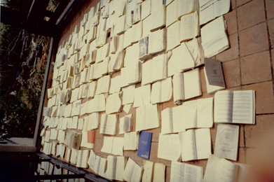
HURRICANE HUGO ’89 contd.

Slide 8
HURRICANE HUGO ’89 contd.

Slide 9
Process
Form Disaster Preparedness Committee
Attempt to approach
Adjust timeline
Re-evaluate approach

Slide 10
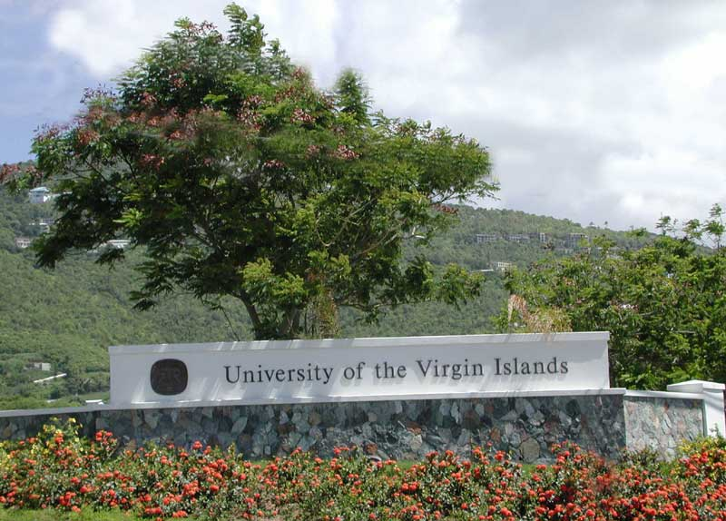
PROJECT TIMELINE
FEB
MAR
APR
MAY-AUG
AUG-SEP
Developing a Disaster Plan (Training)
Disaster Planning Workshop
Library Disaster Preparedness Committee Meeting
Research Disaster Plans, Gather Information,
Write Disaster Plan Draft
Ordered/Received 2 Emergency Response Kits

Slide 11
CHALLENGES
UVI’s 50th Golden Jubilee Anniversary—Historic Photographs Project.
Library Collections Inventory

Slide 12
OUTCOMES
Training
Purchase Recovery kits
Library Disaster Preparedness Plan Draft
Overcoming adversity

Slide 13
SUMMARY/CONCLUSION
Developing a library disaster plan is an on-going process.
Form relationships
Training
“A well thought out and presented plan is useless if it
exists solely as a document on a shelf”. (Lyall, 1993)

