Slide 1
HBCU Leadership Institute: Implementing a Virtual Reference Service
Ms. Morgan M. Montgomery,
Reference Librarian
Claflin University

Slide 2
Abstract
Morgan M. Montgomery, Reference Librarian, H.V. Manning Library, Claflin University
Mentor: Mrs. Jean Greene, Director of Library Services & Archives, William H. Holtzclaw Library,
Hinds Community College- Utica Campus, Utica, MS
Currently there is a need to expand the range of reference services offered at the H.V. Manning
Library on the Campus of Claflin University. Our patrons range from traditional students
to nontraditional students in the universities Continuing Education program and Fort
Jackson cohort. The issue at hand is how does the Reference Department reach all patrons?
By implementing a Virtual Reference Service (VRS), patrons will be able to connect to the
reference librarian regardless of their physical location – allowing reference question to be
answered in real time.
The aim of this project is to “meet patrons where they are” through the design of a virtual
reference program. Utilizing instant messenger software (i.e. Yahoo! Messenger or Meebo)
the expansion of online services will allow users to contact the H.V. Manning Library from their
smartphone, tablet, or pc. Reference interviews and inquiries will occur in real time; expanding
H.V Manning’s online presence and the reach of information literacy.

Slide 3
Initial Concerns
Ease of implementation
Staffing the virtual reference service
Maintaining accurate monthly reports
Generating a buzz for the service
Encourage students and faculty to utilize the service

Slide 4
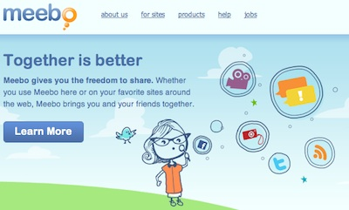
Consider the Options Available (Option 1)
Meebo Messenger:
Pros: Software is free
Meebo Chat messenger can support the following interfaces:
Yahoo! Instant Messenger
AOL Instant Messenger (AIM)
MSN Instant Messenger
Google Talk
Facebook

Slide 5
Meebo Messenger
Cons:
Meebo messenger is not designed to collect virtual reference statistics.
“We do not have any way to track user statistics and we do not save the logs from widgets. If that is something you are interested in, you would need to do it manually.” –April 9, 2012, Meebo Support Team
Furthermore, this would make generating monthly reports for this service very difficult. It would be hard to track patron research needs.
Only July 11, 2012 All embedded Meebo Me widgets will cease to function.

Slide 6
OCLC QuestionPoint™ Cooperative virtual reference (Option 2)
April 12, 2012 attended a webinar entitled
“QuestionPoint: Facts, Features and Functionality”
QuestionPoint reference management service provides libraries with tools to interact with users in multiple ways, using both chat and email. The Web-based chat tool coupled with the email reference component enables seamless integration of chat, follow up and referral, as well as one-stop reporting tools for all types of reference services. In addition, your libraries may opt to participate in the 24/7 Reference Cooperative to provide live around-the-clock reference service to your school and community

Slide 7
OCLC QuestionPoint™ Cooperative virtual reference
Reference staff had the opportunity to view the QuestionPoint webinar and provide feedback.
“This would be a great way to keep statistical records of reference questions and assure that questions are answered when we are not physically available. The question is will patrons use this service? We need to prepare to spend much time steering them in this direction because this is the trend.”
Ms. Bradley, Evening Reference Librarian

Slide 8
Trial QuestionPoint™
Two week trial (July 16-August 3,2012)

Slide 9
Pros
Ease of utilization
Resources and tutorials are easy to locate
24/7 to libraries
Ability to chat with co-browse, so students can see what you are doing
Ability to keep a log of reference questions and statistics
Ability to set up a private queue just for Claflin University students
Resources to promote QuestionPoint

Slide 10
Next Steps
Continue to utilize the free trial
Solicit feedback from staff
Implement a timeline to purchase QuestionPoint
Design a strategy to market and promote the Virtual Reference Service to the H.V. Manning Library’s patrons

Slide 11
What were the most significant challenges?
The most difficult challenge was selecting a vendor. I had opted to go with free chat software vendor Meebo, but upon further research I discovered that Meebo had ceased operation July 2012.
I decided to participate in a webinar featuring OCLC’s QuestionPoint software. Utilizing a free trial of OCLC’s QuestionPoint software helped me to realize that QuestionPoint was a good fit for the H.V. Manning Library by taking into consideration the size of our staff and staffing the Virtual Reference Service.
Another challenge I faced was marketing the service. Currently I am focusing on word of mouth publicity by promoting the service during Information Literacy sessions. Bookmarks have been designed to promote the service and a library training session will be held for faculty, staff, and students to learn more about the service.

Slide 12
Who were the stakeholders, how did you identify and involve them, what were the key change issues, how were they managed?
The key stakeholders were the entire Claflin University faculty, staff, and students (traditional and Continuing Education, and Fort Jackson cohort). Faculty members were involved by being informed of this ongoing project. The Information Technology Department was a direct partner in helping to implement the setup, look and the feel, and functionality of the virtual chat instant messenger. Several meetings were held with the Information Technology Department to update them on the status of the setup of the Virtual Reference Service.
Notes:
Left to right: Standing: Provost Karl S. Wright, Ms. Marilyn Y. Gibbs, Library Director, Ms. Patricia Bradley, Weekend Reference Librarian
Seated: Mrs. Jean B. Greene, Ms. Morgan Montgomery, Reference Librarian

Slide 13
What resistance did you encounter, how did you manage it, what was the response?
I did not encounter any resistance.
The only issue had I was having to change my original idea of going with a particular chat service.

Slide 14
What insights and learnings from the Leadership Institute were most helpful in implementing this project?
What I learned from the Institute was that it was ok to take a moment to step back and absorb the process. Also, learning about the different personalities and how to deal with people helped me to learn to alter my approach in working with other staff members.

Slide 15
How did the initiative fit into the university strategic plan?
The initiative fit into Claflin University’s strategic plan because it highlights the following tangents: leadership development, student development, faculty and staff development.
Leadership specifically because the Leadership Institute gave me the opportunity to design and implement this project, and learn the skills needed to be an effective leader.
Students, faculty and staff development because this project gives them the opportunity utilize an additional service of the H.V. Manning Library while strengthening their technology and research skills.

Slide 16
Summary
To summarize the Virtual Reference Service “Chat with the Librarian” service is up and running and faculty, staff, and students are utilizing the program. This project taught me how to deal with change head on, and instead of getting frustrated, use the frustration to pause and take a moment to reflect.
Furthermore, I learned that leaders need to be knowledgeable in dealing with different personality types. I realize that succession planning is ever evolving and that includes in some way, shape, or for involving your teammates. Most of all I have learned to hold myself accountable and actually start seeing myself as a leader. As I leader must have passion and know my purpose. I have realized that balance is crucial both professionally and personally.

Slide 17
Chat with a Librarian Instant Messenger

Slide 18
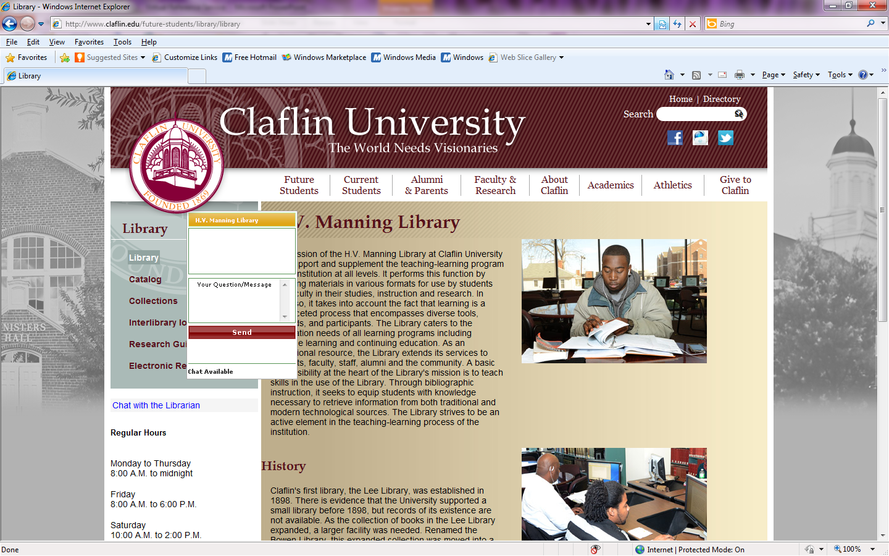
Chat with a Librarian Instant Messenger

