Slide 1
Enhancing Critical Thinking Skills
2012 HBCU Library Alliance Leadership Institute
Presented By:
Violene Williams, MLIS
Reference Librarian
James Herbert White Library
viwill@mvsu.edu
Mississippi Valley State University

Slide 2
Abstract summary
Introduction
Project Goals
Structure
Procedure
Overall Outcomes
Key Innovations
Project Review
Challenges
Stakeholders
Resistance
Insights and Learnings
Summary and Conclusion
OUTLINE

Slide 3
MVSU has a 91% African American student population with an average ACT score of 17 for incoming freshmen
The librarians of the J. H. White Library provided Information Literacy instructional services to first year students to help them complete assignment and conduct basic information research.
The classes were held for one hour and thirty minutes three days a week.
To assess the students’ critical thinking abilities, a pretest was given the first day of class and a post-test was given on the last day to evaluate the students’ progress and the success of the project.
Abstract
Notes:
Given that Mississippi Valley State University (MVSU) has a 91% African American student population with an average ACT score of 17 for incoming freshmen, one could conclude that MVSU incoming freshmen are unprepared to do college level course work. The James H. White Library provided Information Literacy instructional services to first year students to help them complete assignment and
conduct basic information research. The classes were held for one hour and thirty minutes once a week. To assess the students’ critical thinking abilities, a pretest was given the first day of class and a post-test was given on the last day to evaluate the students’ progress and the success of the project.

Slide 4
To increase relational ties between faculty and librarians with an eye toward getting faculty to recognize librarians as instructors and partners
To promote first year students’ awareness of information literacy
To enhance students’ critical thinking skills using information literacy standards
Project Goals

Slide 5
The librarian hope not only to teach the skills necessary to document a research paper, but also to alleviate fears and apprehension about the process by making it logical and transparent
The students were introduced to the structure of information, methods of accessing information resources, and retrieval of documents by the librarian
Structure

Slide 6
Three English 101 classes were scheduled to evaluate students’ critical thinking skills
Pre-test was given on the first day of class and a post test was given on the third day of class
Several activities and exercises were strategically situated into the course schedule and included topics such as nature and structure of information and accessing information resources
Process
Notes:
A pretest and post- test was administered to students to assess the impact of the pilot. The first day of class student learned how to access the James H. White Library Webpage. Students learned how to conduct a card catalog search using author, title, keyword and subject to identify and locate the call number of various information resources. Tutorials, discussions and activities were done in class relating to the card catalog. Card catalog assignment were issued and due next class meeting.
The second day of class students learned how to choose a topic and narrow the focus of a topic. Choosing a topic assignment issued and was due next class period. Students learned how to evaluate source validity and reliability and identify reference resources and Internet sites appropriate for searching specific topic. Students learned how to retrieve articles from electronic format or databases, Internet searches and truncation. Students were also introduced to Research Methods, Plagiarism and other.
The third day of class students learned how to construct search strategies using keywords/concepts (and/or quotations), implement search strategies in appropriate electronic databases, use the online help options found in databases and analyze search results and revise if necessary.

Slide 7
Group A
Day 1: Pre- test administered and explained program goals and objectives. Students will learn to demonstrate awareness of how to use a library collections and services and how to use the internet to access a library’s webpage.
Day 2: Students will learn about choosing a topic and narrowing the focus of a topic. Choosing a topic assignment issued and due next class period.
Day 3: Students will learn to construct search strategies using keywords/concepts (and/or, quotations), implement search strategies in appropriate electronic databases, use the online help options found in databases and analyze search results and revise if necessary.
Activities and Assignments
Notes:
A pretest and post- test was administered to students to assess the impact of the pilot. The first day of class student learned how to access the James H. White Library Webpage. Students learned how to conduct a card catalog search using author, title, keyword and subject to identify and locate the call number of various information resources. Tutorials, discussions and activities were done in class relating to the card catalog. Card catalog assignment were issued and due next class meeting.
The second day of class students learned how to choose a topic and narrow the focus of a topic. Choosing a topic assignment issued and was due next class period. Students learned how to evaluate source validity and reliability and identify reference resources and Internet sites appropriate for searching specific topic. Students learned how to retrieve articles from electronic format or databases, Internet searches and truncation. Students were also introduced to Research Methods, Plagiarism and other.
The third day of class students learned how to construct search strategies using keywords/concepts (and/or quotations), implement search strategies in appropriate electronic databases, use the online help options found in databases and analyze search results and revise if necessary.

Slide 8
Group A
Day 1: Pre- test administered and explained program goals and objectives. Students will learn to demonstrate awareness of how to use a library collections and services and how to use the internet to access a library’s webpage.
Day 2: Students will learn about choosing a topic and narrowing the focus of a topic. Choosing a topic assignment issued and due next class period.
Day 3: Students will learn to construct search strategies using keywords/concepts (and/or, quotations), implement search strategies in appropriate electronic databases, use the online help options found in databases and analyze search results and revise if necessary.
Activities and Assignments
Notes:
A pretest and post- test was administered to students to assess the impact of the pilot. The first day of class student learned how to access the James H. White Library Webpage. Students learned how to conduct a card catalog search using author, title, keyword and subject to identify and locate the call number of various information resources. Tutorials, discussions and activities were done in class relating to the card catalog. Card catalog assignment were issued and due next class meeting.
The second day of class students learned how to choose a topic and narrow the focus of a topic. Choosing a topic assignment issued and was due next class period. Students learned how to evaluate source validity and reliability and identify reference resources and Internet sites appropriate for searching specific topic. Students learned how to retrieve articles from electronic format or databases, Internet searches and truncation. Students were also introduced to Research Methods, Plagiarism and other.
The third day of class students learned how to construct search strategies using keywords/concepts (and/or quotations), implement search strategies in appropriate electronic databases, use the online help options found in databases and analyze search results and revise if necessary.

Slide 9
Students who participated in the program left with the ability to:
Determine the extent of information needed
Access the needed information effectively and efficiently
Evaluate information and sources critically
Incorporate selected information onto one’s knowledge base
Use Information effectively to accomplish a specific purpose.
Understand the economic, legal, and social issues surrounding the use of information, and access ethically and legally
Overall Outcomes
Notes:
Positive educational outcome for students
Good relational ties with faculty
Enhanced critical thinking skills for students who are underprepared for freshmen college course level work
The information provided in this study indicates the need for information literacy classes for first year students. Information literacy has been a concern of librarians for many years, they believed students were not learning the library skills needed to become successful lifelong learners. Information literacy will allow librarians to teach students how to find and evaluate resources that are appropriate for academic work.
The Pre-Test Scoring Rubric
Basic 0-4 Intermediate 5-7 Advanced 8-10
The average pre-test score for group A, B and C were as follows 7.87, 8 and 7.375. Each group from the pilot scores were similar for the pre-test.
Intermediate level indicates that they understood at least 50% of the basic concepts about the library prior to information literacy instruction.
Advanced level indicates that they understood at least 75% of the basic concepts about the library prior to information literacy instruction.
Post-Test Scoring Rubric
Basic 0-5 Intermediate 6-13 Advanced 14-19 Mastered 20-26
The average post- test score for group A, B and C were as follows 21.31, 22.1875 and 21.31.
The average score from the post-test indicate that most of the students scored at the mastered level indicating that they understood at least 90% of the information literacy concepts covered during instruction.
Although there was no significant statistical difference between the pre-test scores and post-test scores, students still benefitted from the class. The lack of significant difference in scores seems to indicate that the concept taught in the course need to be elevated to become more challenging to the students.

Slide 10
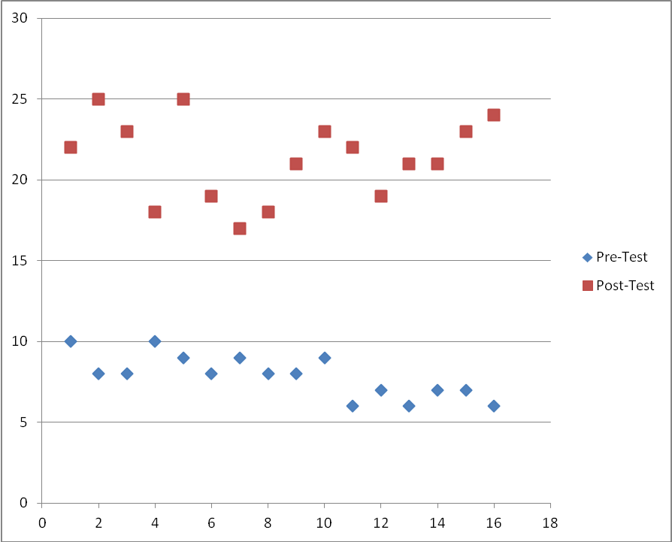
Scatterplot of Group A Scores
Scatterplot of Group A Scores
Group A Scores
Overall Outcomes
Notes:
Positive educational outcome for students
Good relational ties with faculty
Enhanced critical thinking skills for students who are underprepared for freshmen college course level work
The information provided in this study indicates the need for information literacy classes for first year students. Information literacy has been a concern of librarians for many years, they believed students were not learning the library skills needed to become successful lifelong learners. Information literacy will allow librarians to teach students how to find and evaluate resources that are appropriate for academic work.
The Pre-Test Scoring Rubric
Basic 0-4 Intermediate 5-7 Advanced 8-10
The average pre-test score for group A, B and C were as follows 7.87, 8 and 7.375. Each group from the pilot scores were similar for the pre-test.
Intermediate level indicates that they understood at least 50% of the basic concepts about the library prior to information literacy instruction.
Advanced level indicates that they understood at least 75% of the basic concepts about the library prior to information literacy instruction.
Post-Test Scoring Rubric
Basic 0-5 Intermediate 6-13 Advanced 14-19 Mastered 20-26
The average post- test score for group A, B and C were as follows 21.31, 22.1875 and 21.31.
The average score from the post-test indicate that most of the students scored at the mastered level indicating that they understood at least 90% of the information literacy concepts covered during instruction.
Although there was no significant statistical difference between the pre-test scores and post-test scores, students still benefitted from the class. The lack of significant difference in scores seems to indicate that the concept taught in the course need to be elevated to become more challenging to the students.

Slide 11
Finding ways to introduce information literacy to the students.
Making class interesting not boring
Involving students in the weekly activities
By listening to the students when they speak
Getting to know the students to determine how they think
Students did hands on assignments during class
Key Innovations

Slide 12
The original plan was to go into the high school and teach high school juniors and seniors Critical thinking Skills (Information Literacy classes)
Due to the fact that no funds were available the project participants were changed
Had to determine what other audience we could use as our target without having to change too much else about the project
Challenges

Slide 13
Had limited time in which to do actual instruction
Once target was confirmed, had to teach enough classes to ensure integrity of data
Had to get faculty buy-in
Challenges Continued

Slide 14
The stakeholders for the project were:
MVSU Freshmen Students
James Herbert White Librarians
MVSU Teaching Faculty
MVSU Administration
Stakeholders

Slide 15
The initial project met with some resistance from the local high school principal
However, the revised project met with no resistance from the faculty, university administration nor the students
Project Resistance

Slide 16
Learned to talk, listen, and act together
Learned how to have a crucial conservation
Learned to apologize when appropriate
Learned to expect the unexpected
Learned that not everyone believes in your work
Learned how not to give up
Insights Gained

Slide 17
This project will give MVSU an opportunity to increase the percentage of incoming freshmen who are capable of handling college level work
This program helped me to tell a story about information literacy to first year MVSU underprepared students and how to have a crucial conversation
Conclusion
Notes:
· The library will also benefit in that the data gathered from this project will be used as an impetus to establish a formal Information Literacy Program.

Slide 18
This project aligns itself with the following university strategic goals:
Develop educational programming with the local K-12 institutions and pre-K facilities to bring students to campus for purely academic endeavors
Embrace the niche of service to the underserved and underprepared
Establish and enhance formal connections between academic departments and high schools (University)
Librarians will provide information services for faculty, staff, students and the community users we do not see (Library)
University Strategic Plan
Notes:
· The library will also benefit in that the data gathered from this project will be used as an impetus to establish a formal Information Literacy Program.

Slide 19
Ms. Adrienne Webber
Dean of Library and Information Services
Miller F. Whitaker Library
South Carolina State University
Ms. Mantra Henderson
Director of Library Services
James H. White Library
Mississippi Valley State University
Thanks

Slide 20
Questions and Answers

