Slide 1
The 21st Century Educator and Information Literacy
Dr. Mae L. Rodney – Director of Library Services
Cotina Jones – Support Services’ Coordinator
Winston-Salem State University C.G. O’Kelly Library

Slide 2
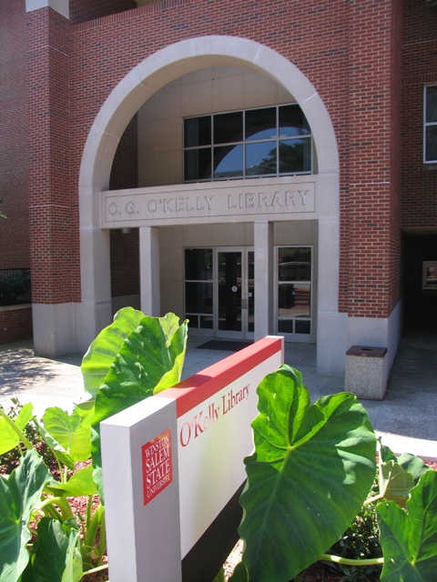
Agenda
Project Summary
Goal
Structure
Process
Breakthroughs / Innovations
Significant Challenges
The Change Model
The Immunity Map
Conclusions

Slide 3
Abstract Summary
A series of information literacy workshops will be held that are specifically geared for those in the School of Education. Separate sessions will be offered for the faculty members, current student teachers, students enrolled in the graduate and certification only programs. Workshops will also be held for Winston-Salem Forsyth County Schools educators Participants will receive a stipend or other incentive. We applied for an IMLS grant to fund this program.

Slide 4
Project Introduction
Project aimed at closing the Information literacy gap for students
Geared at reaching the educators in Winston-Salem Forsyth County Schools, Winston-Salem State University School of Education and Health and Human Performance faculty, and students enrolled in the preclinical semester
Involves planning and implementing a series of workshops offered during the academic year and the summer

Slide 5
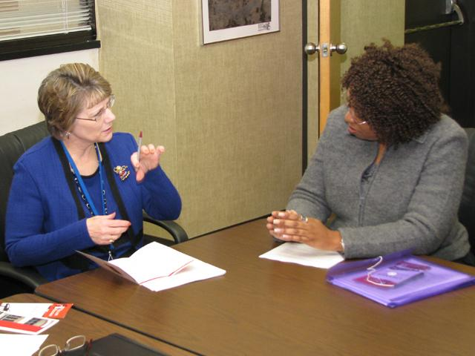
Breakthroughs / Innovations
Winston-Salem Forsyth County Schools administration quickly agreed to participate in the program.
Even though the coordinator of the teacher education program could not be a co-pi for the grant she quickly agreed to work with the library in any way that she could to ensure the success of the program.

Slide 6
Significant Challenges
Expanding the idea for the program from 2 -3 sentences on a page into a program that is possible if the funds are available
To meet this challenge there were formal and informal meetings with potential stakeholders and program participants
Applying for the Laura Bush 21st Century Librarian Grant
To meet the challenge we worked closely with the Office of Sponsored Programs and Research

Slide 7
The Change Model
The stakeholders:
Winston-Salem Forsyth County Schools educators, School of Education and Human Performance faculty, librarians, and library technical assistants
How were they identified and involved?
Change issues?

Slide 8
Immunity Map
Identify the visible commitment to this issue:
The library’s primary focus is on teaching information literacy skills to students and faculty
What are we doing? Not doing?
The library provides staff development opportunities to the library staff to ensure that they are able to effectively assist students and faculty.
The library also provides one-on-one consultations to students and faculty as requested

Slide 9
Immunity Map
What are the hidden commitments?
How are we going to be able to teach all of these potential classes?
On the faculty members part: will the librarians be able to effectively assist my students?

Slide 10
Immunity Map
What are the big assumptions?
All students come in not knowing how to transfer knowledge of technology from the search engine to database usage
All librarians and faculty members come in with the necessary skills to teach students information literacy
On the faculty members and students part: all the librarians do is work with books
On the part of library administration: the librarians can do it all: teach classes, provide consultation sessions, and complete important projects without getting burned out

Slide 11
Immunity Map
What insight has this concept given you with respect to the change you want to see.

Slide 12
Conclusions and Future Plans
Significant learning:
Changes to leadership approach?

Slide 13
Conclusions and Future Plans
If the library does not receive the IMLS grant there are aspects of the program that will be implemented.
Librarians will still have the staff development experiences to enhance their teaching skills
We will still work with the School of education and Human Performance to stress the importance of information literacy especially since the new state standard course of study has been revised to incorporate information literacy across the curriculum
We will also continue to seek grant funds so that the library will be able to fully offer this program

