Slide 1
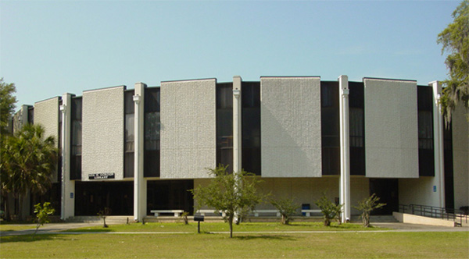
Expanding and Enhancing Instant Messaging in the Library
James Stephens, Systems Librarian
Savannah State University
Notes:
Put in picture of someone being trained.

Slide 2
Overview
Abstract
Goals
What we were doing
What we are doing
How we got there
A few statistics

Slide 3
Abstract
Savannah State University Library has deployed instant messaging widgets throughout its web site in order to better communicate with our students, faculty, and staff. Improved communication will increase our value to our stakeholders at the same time as improving the perception of our value through openness and good customer service. Increasingly, classes are held in online only and in hybrid environments, providing this avenue of communication is essential in order to continue to provide our traditional services to all patrons.

Slide 4
Goals and objectives
Increase communication with students, faculty, and staff, including:
Improved online reference services
Increased access and transparency to all departments
Implement texting reference
Simplify communication among the staff
Notes:
The primary goal of this project has been to open up new avenues of communication between the library and our stakeholders.
This goal includes the following objectives:
Improving our online reference services
Increasing access to all departments
Implementing texting reference services
Simplifying communication between the library staff

Slide 5
What we were doing
Before 2008:
Email reference only
2008-2009:
Meebo “Ask a Librarian”
Notes:
Before 2008, Email was the only online access point. In 2008, we began using Meebo as our first foray into chat.

Slide 6
Problems with Email Reference
Problems are obvious:
Not terribly timely, hours or days for a response
Operator dependant (1:1 communication)
Usually no feedback to patron
No statistics
Very opaque
Notes:
There are many problems with using email as an only option for online communication. These are really problems with email as a medium more so than problems with the usage in reference.
Some of the problems include:
Slow response time. Though this certainly isn’t always the case, it sometimes can be. Slow turn around time is compounded by the 1:1 communication aspect of email. Most of the time, email is going from one person to one person, so if the librarian receiving the message is out of the office, away from the desk, on vacation, whatever, then the message from the patron can go unanswered for a long time. When this occurs, there is usually no feedback to the patron.
Of course, many of these issues can be minimized procedurally; having the right methods in place can ensure that questions aren’t lost in the mix. Email is a good option and should be used in certain situations, but having it as the only method of online communication is very limiting.

Slide 7
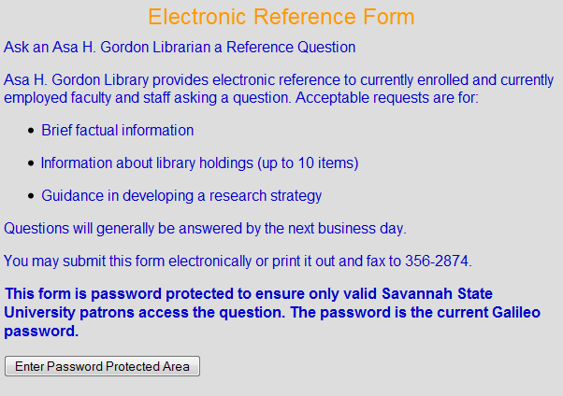
Email Form Protection?
Notes:
Previously, our site was requiring users to put in a password to access the form to submit a question via email. I can’t quite see the utility of doing something like this.

Slide 8
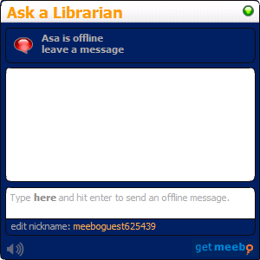
Meebo interface
Notes:
The first chat option we tried was Meebo. Here is an example of the Meebo interface. I suspect many of you are already familiar with Meebo.

Slide 9
Problems with Meebo
Requires Flash
Not customizable
Operator dependant (1:1 communication)
No presence information from the client or browser
No statistics
Basically, a good service, but not all that well suited to our needs in several ways.
Notes:
Meebo is very good service – one of the best things about it is it’s free. But still there were several things that did not work well for us. The meebo widget requires flash, so any computer that doesn’t have flash (or doesn’t have flash turned on) will not even see your chat. With the recent issues between Adobe and Apple, this becomes an even bigger issue. If you want a patron to use your chat on their iphone or ipad, then Meebo is not the answer.
The widget is also not customizable. You can change the color and the size, but that’s it…and you can’t even change all of the colors. Try as I might, I could never get the look of the widget to gel with the look of our website in a satisfactory way.
The same issues with 1:1 communication apply to Meebo. Only one person can be signed on to monitor the chat. If that person gets busy, questions can get missed.
The lack of presence information means that if the librarian walks away from the computer without logging out of Meebo, the widget will always say that the librarian is online. This often causes missed questions.

Slide 10
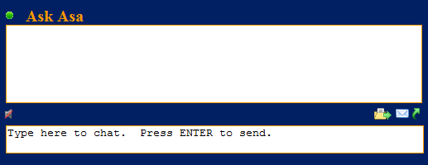
What We’re Doing Now
Libraryh3lp
The Libraryh3lp widget:
Notes:
Which brings us to what we have implemented through this project: Libraryh3lp.
This is the main libraryh3lp widget on our home page. This however is just one of many. We have widgets on nearly every page of our site, on our facebook page, on our blog, and in our libguides.
Unlike Meebo, libraryh3lp is not a free service, though it is very affordable. If you have less than 10,000 FTE, the annual cost is $250.

Slide 11
Benefits of Libraryh3lp
Fully customizable interface
Doesn’t require Flash
Uses a queue system that allows for multiple operators at once as well as multiple queues
Has very good presence indicators
Keeps great statistics
Includes texting functionality
Notes:
The interface is completely customizable, I can make it look exactly how I want it to look. I ended up using a fairly basic design, but I explored several more far out options before settling on this one.
The interface uses basic javascript which virtually everyone has. Older computers may not have or be able to run up to date flash, and flash isn’t available on many mobile devices. Flash also loads on the screen significantly slower than javascript.
Probably the biggest difference is that Libraryh3lp uses a queue system that allows for multiple operators at once. That way, no one person is tied to a computer. We have six librarians – including our library Director – on the Reference Queue. I’ll explain how this works a little more later.
With libraryh3lp, we get very good presence indicators; when an operator is away from the desk, that operator will not receive questions, and when every one on a queue is offline, the queue will automatically go offline as well. With Meebo, the only presence detection was to detect whether the operator was logged in. If he or she was, then chat was online…if the person is away from the desk for a few minutes, or forgets to sign out at the end of the day, the chat will stay online and all questions will go unanswered.
This software keeps great statistics, and I will share some later.

Slide 12
How it works
There are several queues for different functions
There is a widget for each queue
There are several staff assigned to each queue
Staff members have a chat client installed
Questions go to all staff assigned to that queue
The first staff member to answer “wins” and all other staff are closed out
Notes:
I don’t want to spend too much time discussing the ins and outs of the software, but here is a brief overview of how the system works.
There are multiple queues set up. We have 11 queues. So far only the Reference queue and the e-Learning help queue have gotten significant use, but in addition to those we have a queue set up for each department within the library as well as setting up the ability to chat directly with any of the staff members.
There is a widget on almost every page of the library’s webpage, each one going to the appropriate queue. The widgets can all be individually designed or they can all look the same.
All of the librarians are assigned to the reference queue; and each member of each department is assigned to the queue for that department…so the Collection Development staff receive questions that are typed into the chat widget on the Collection Development department page. Etc
Each staff member has a chat client installed on their machines. The libraryh3lp service works with any XMPP Jabber client. We use a fairly common chat client called Pidgin, but you can use many different chat clients.

Slide 13
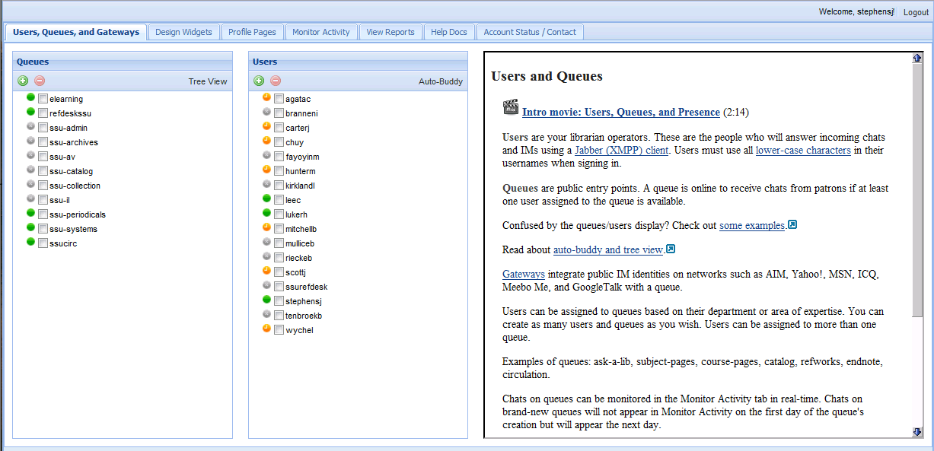
Libraryh3lp Console
Notes:
This is an image of the libraryh3lp console. From here you can create your queues and add users and on the other tabs you can design your chat widgets, monitor activity, and view statistics.

Slide 14
Texting
Works in conjunction with Google Voice
Uses a standard phone number
Texts are received in the staff clients
Notes:
Through Libraryh3lp, we also have the added ability of texting services. Patrons can send text questions to a regular phone number that then get sent directly to the clients. They appear exactly the same way that chat questions appear.

Slide 15
How we got there
Evaluation
Testing
Make widgets
Training
Deployment
Gather Statistics
Notes:
Evaluated what we were doing, and the problems with it. Looked around at other options out there.
Libraryh3lp has a nice feature in allowing extended testing. I made an account with them, and started experimenting with the software months before we paid for it.
From the management console I designed the widgets for the various parts of the web site with the input of the staff.
Training was not terribly difficult because most people are already at least somewhat familiar with chatting. The differences between libraryh3lp chat and regular 1:1 chat are minimal, and really only apparent in the queue system.
Primary deployment occurred over the break between fall and spring semesters.
Gather Statistics…need to do this

Slide 16
Statistics
We have so far received:
391 questions via chat or text.
261 questions on the reference queue
112 questions on the e-Learning queue, and
18 questions for all other departmental queues
Notes:
Here are some of the basic statistics:

Slide 17
Wait time per Reference Librarian
Operator # Mean Median Min Max
agatac 36 18s 9s 4s 2m45s
fayoyinm 1 1m22s 1m22s 1m22s 1m22s
kirklandl 53 17s 8s 3s 2m30s
lukerh 17 29s 19s 5s 3m37s
mulliceb 1 2m34s 2m34s 2m34s 2m34s
stephensj 66 16s 7s 2s 6m32s
tenbroekb 7 24s 10s 8s 1m12s
wychel 21 1m5s 16s 9s 9m32s
Notes:
The statistics are much more elaborate than that. As you can see here, they get down to a granular level such as the average time that a user has to wait for each librarian to answer questions from the queue.
We can also see the busiest days, the busiest times of day, etc.

Slide 18
Day of the week

Slide 19
Questions by Hour

Slide 20
Questions and Comments
?

