Slide 1
OOOH…Baby Baby
How to Manage Your Time and Resources as a Student Parent
Bettye Black, Director of Libraries, Langston University
Senta Sellers, Reference and Instruction Librarian

Slide 2
Summing Up
4 Week Family Literacy Program
Parenting Resources
Nutrition
Fitness
Celebrations
For Student Parents & their Children
Promote Healthy Lifestyles

Slide 3
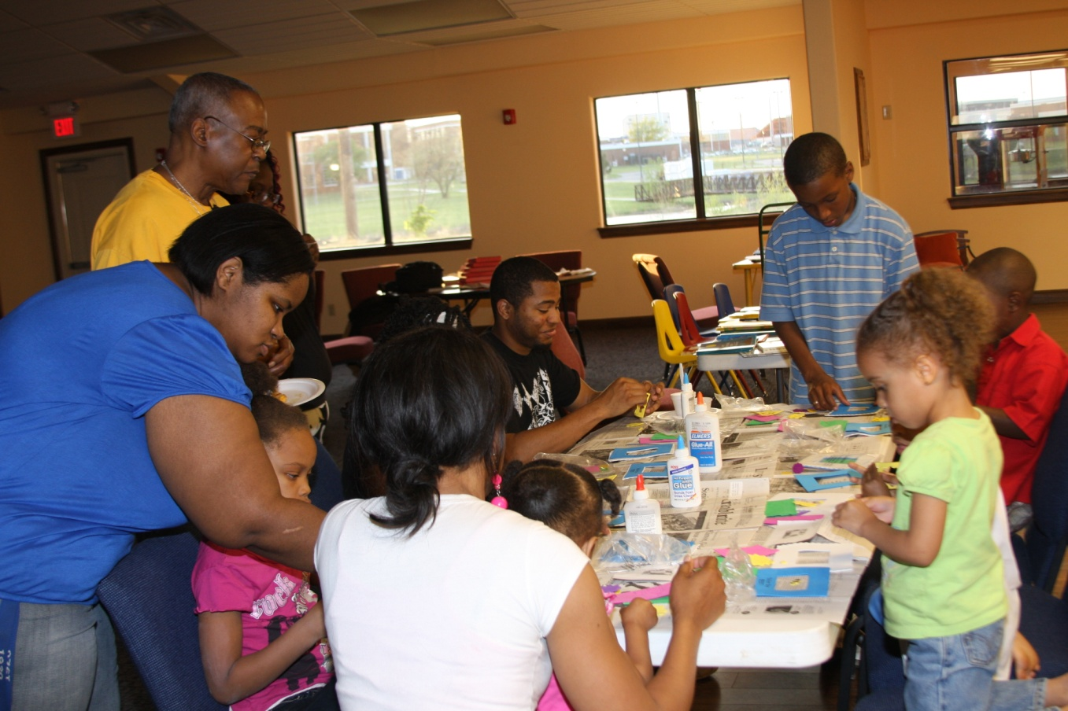
Project Goal
Families participate in physical and creative activities together.

Slide 4
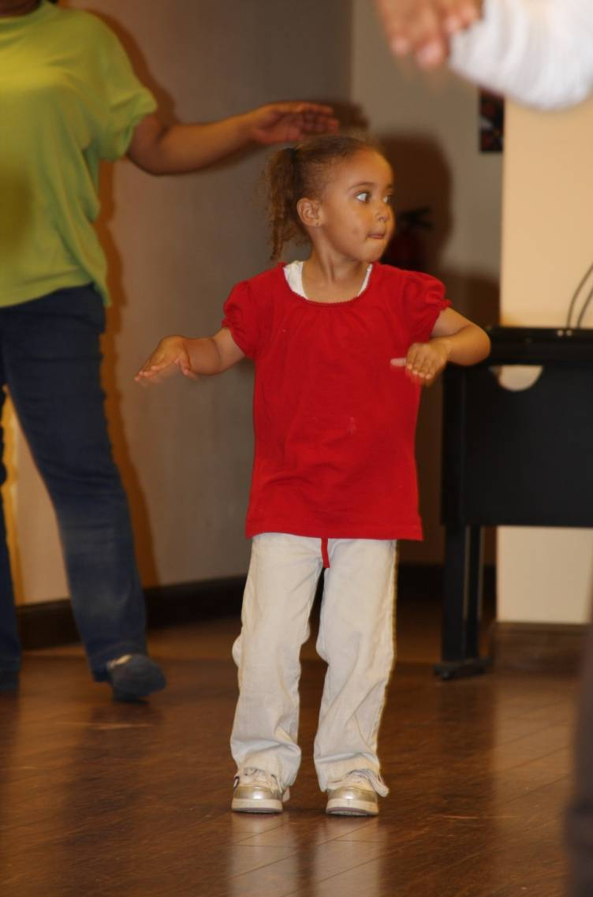
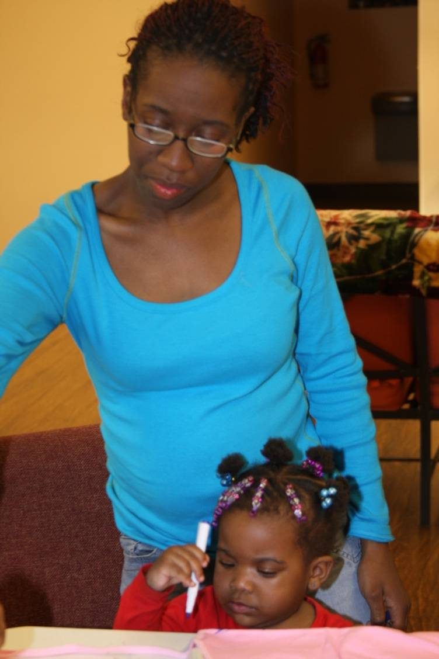
Promote family literacy through non-traditional methods.

Slide 5
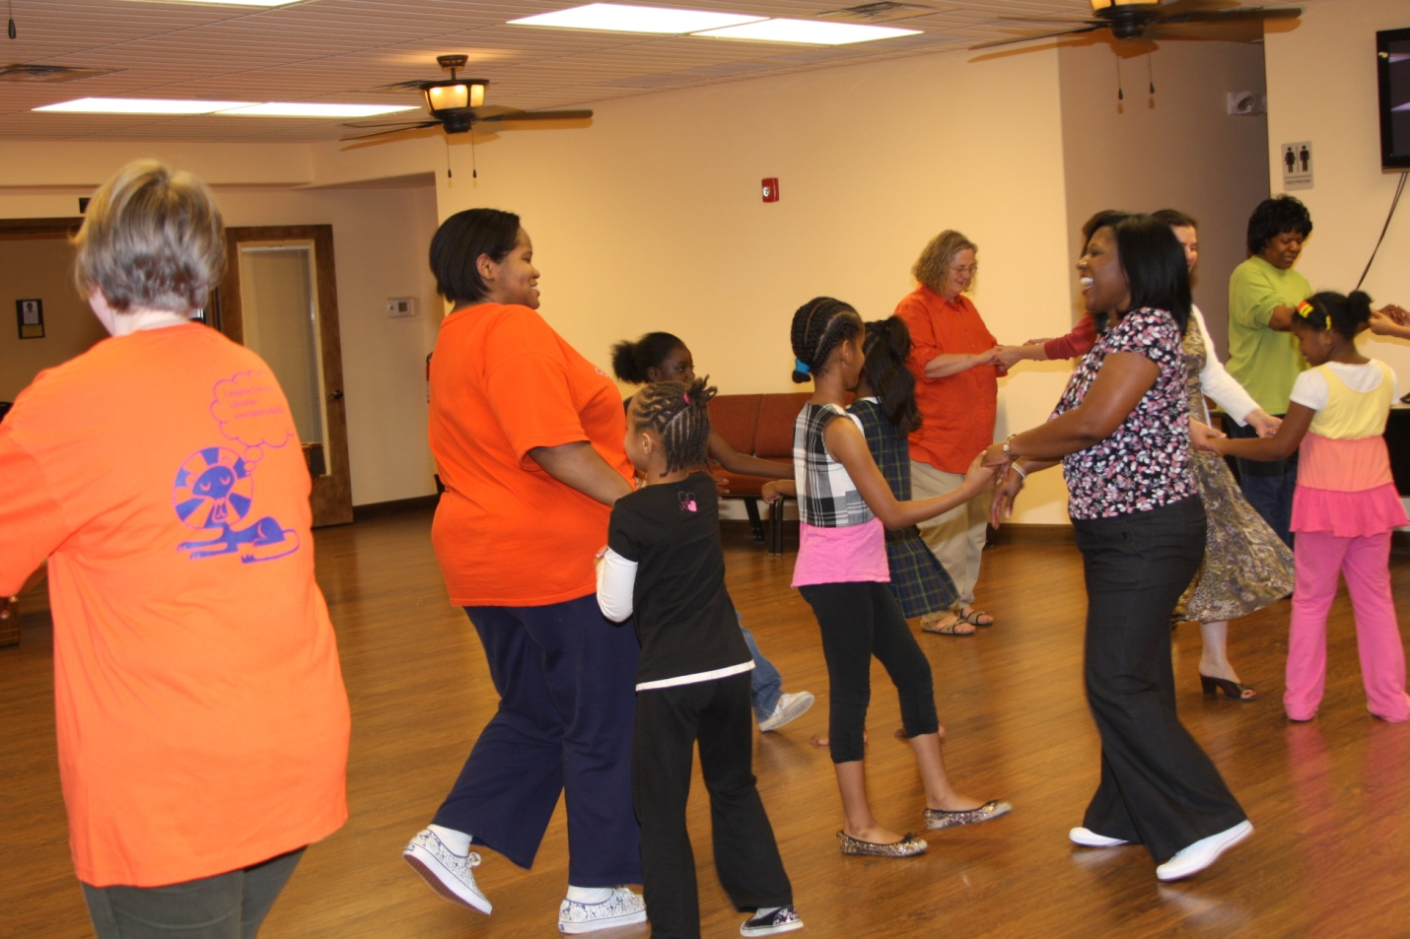
Promote health and wellness for body, mind, and spirit.

Slide 6
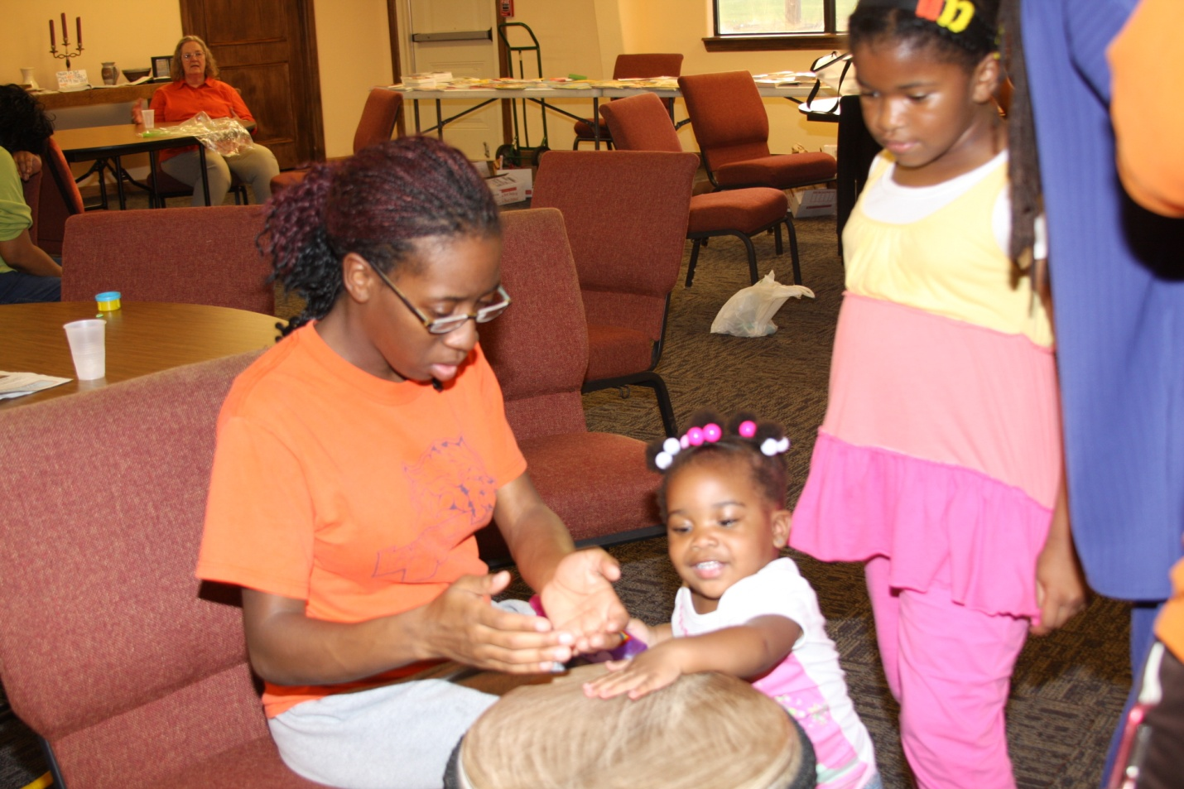
Empower families to engage in activities that are fun and educational.

Slide 7
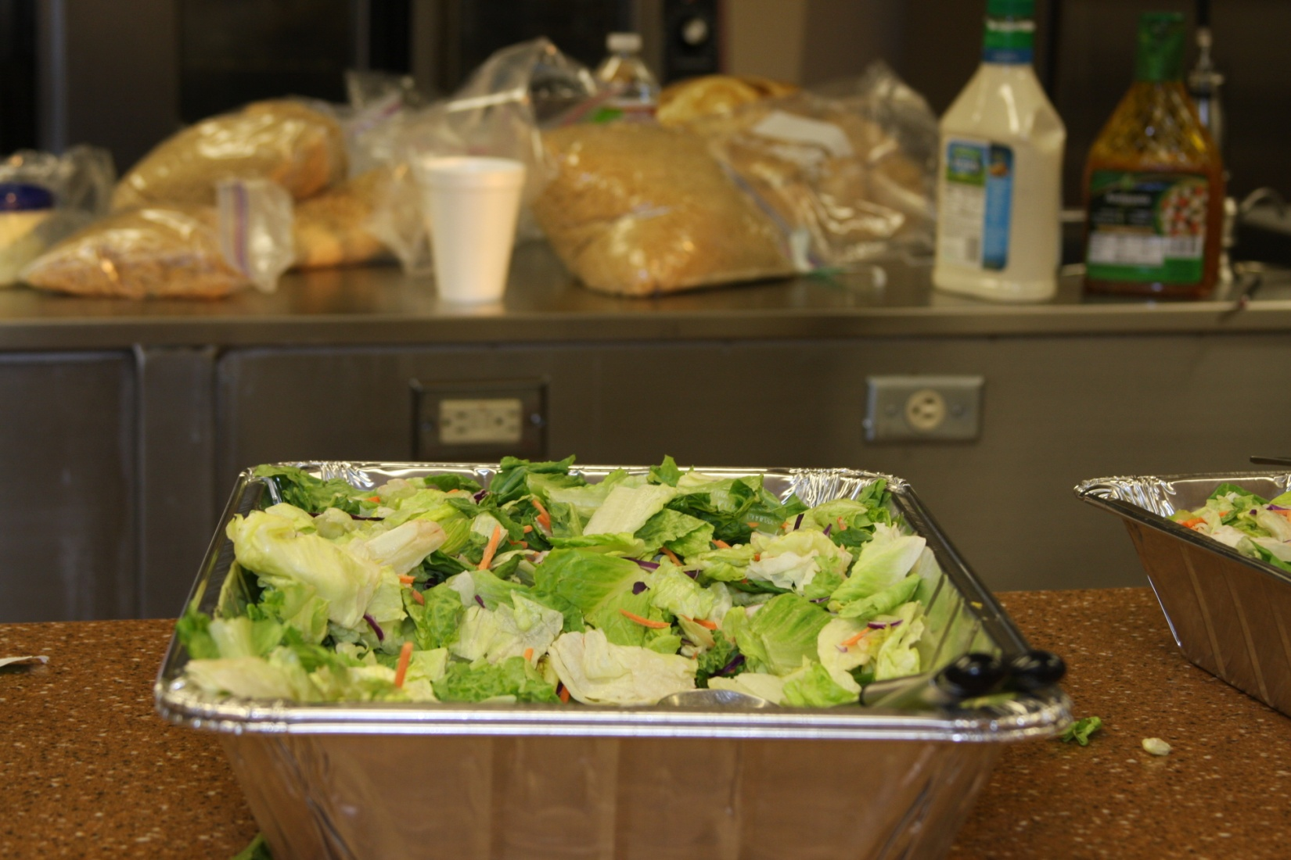
Practice good nutrition.

Slide 8
Week 1: Parenting Resources
WIC
Smartstart
LU School of Physical Therapy
LU School of Nursing
US Department of Human Services
Reading Is Fundamental (RIF) Book Distribution
Arts Activities

Slide 9
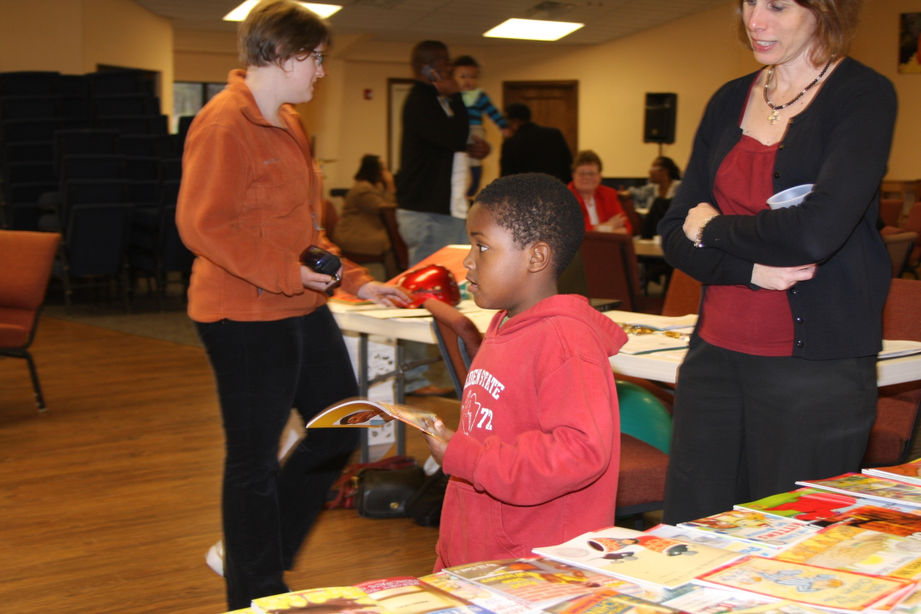
Resources

Slide 10
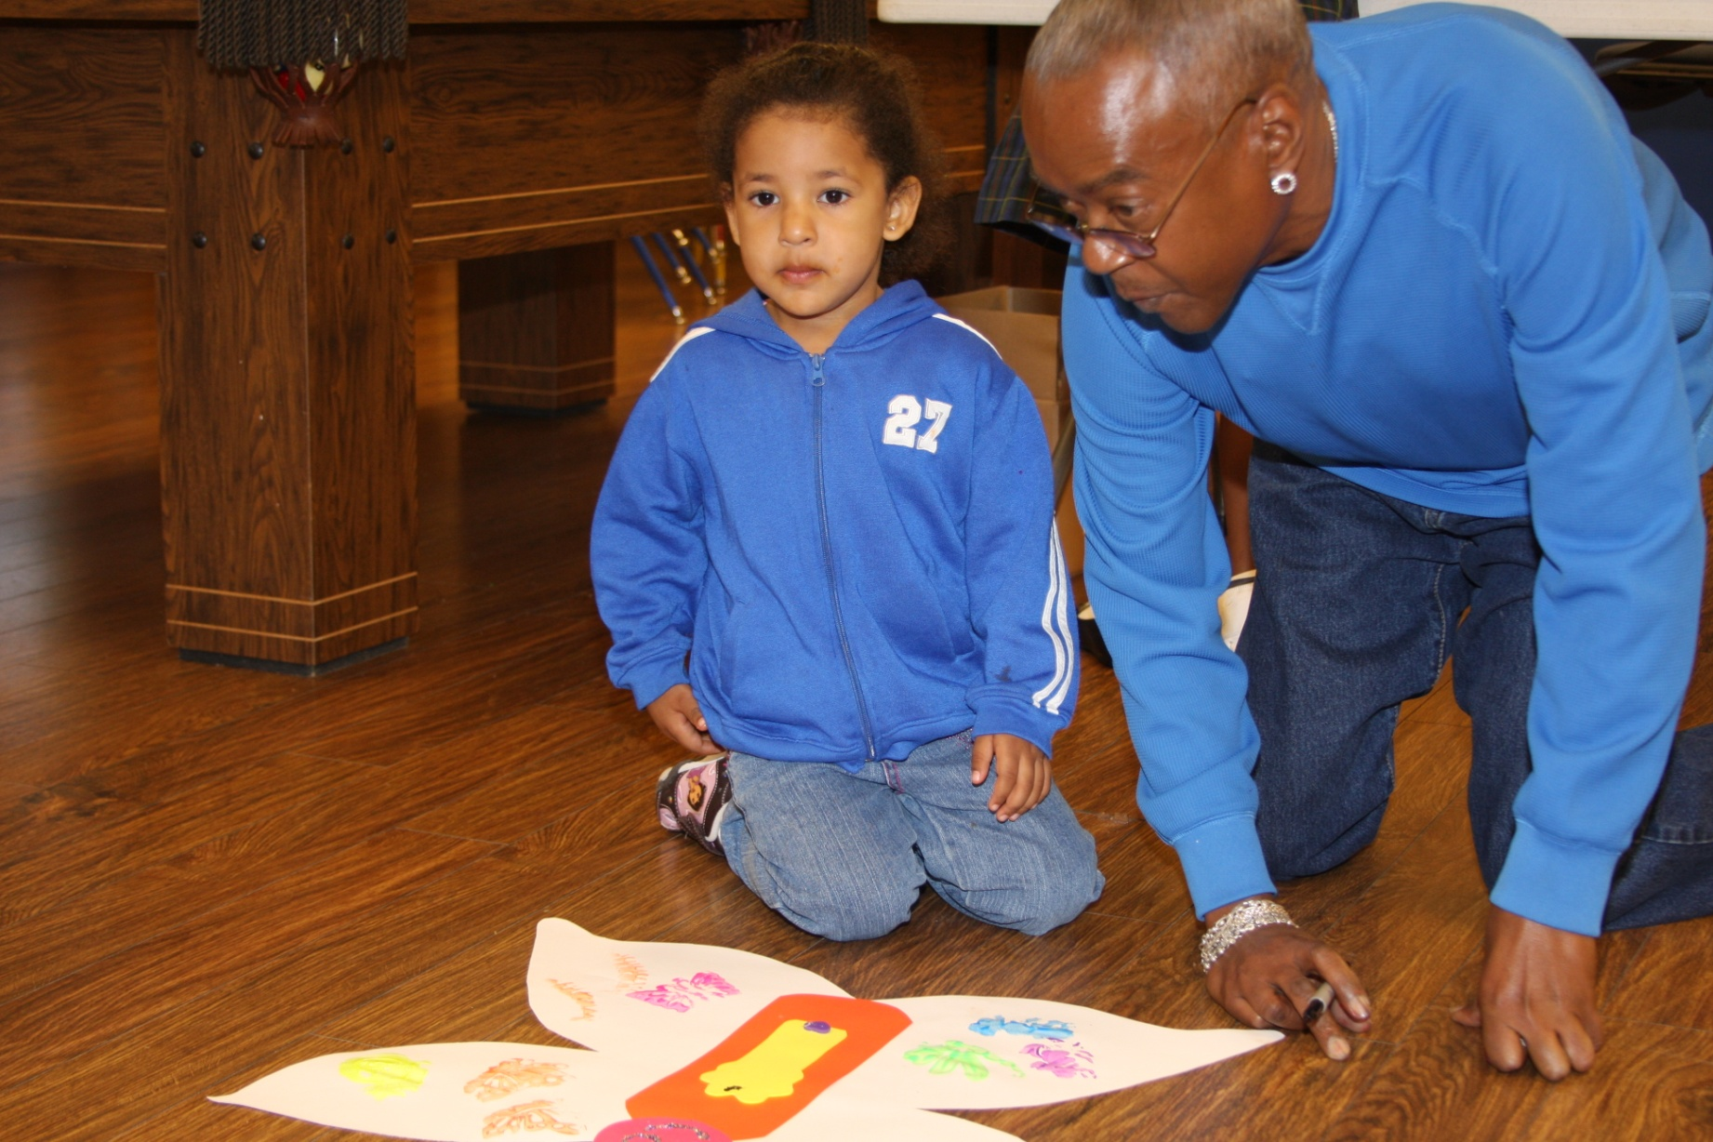
Art Project

Slide 11
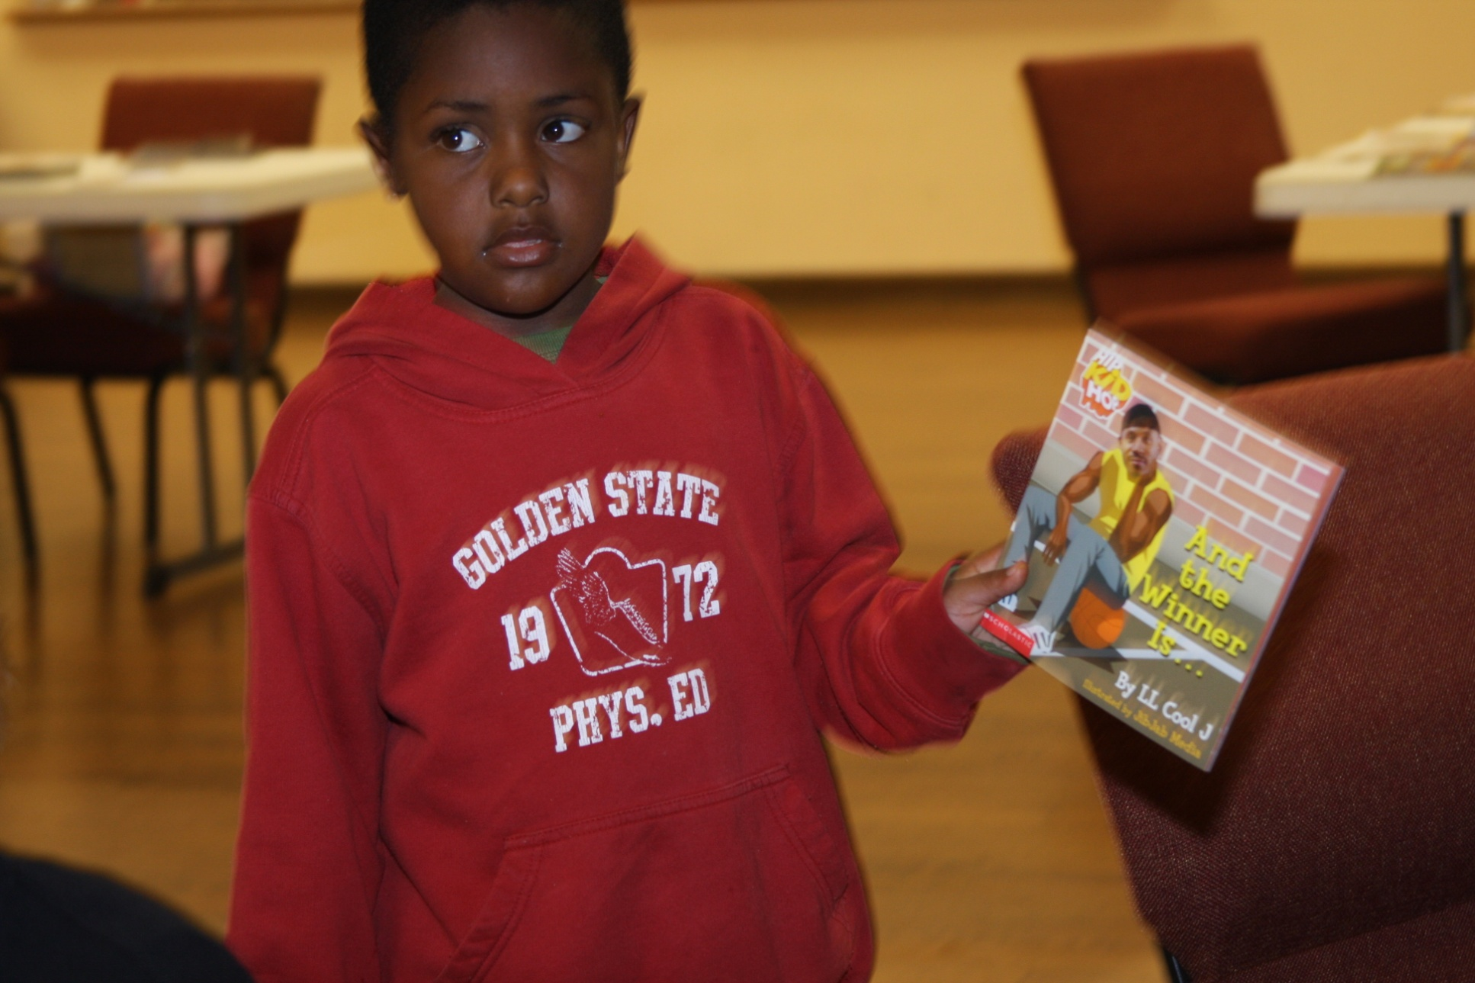
RIF Book

Slide 12
Week 2: Nutrition
Logan County Health Department live cooking show
RIF Book Distribution
Arts Activities

Slide 13
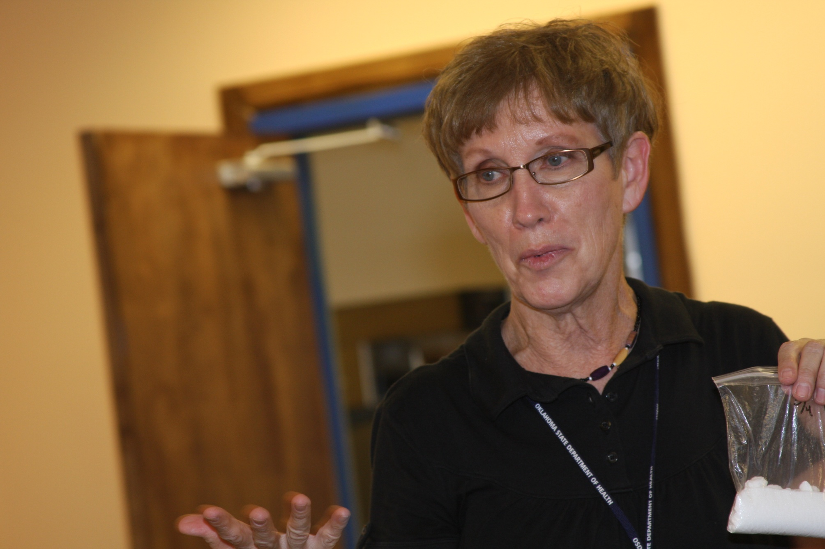
¼ Cup of Sugar in Every 32 oz. Soft Drink!

Slide 14
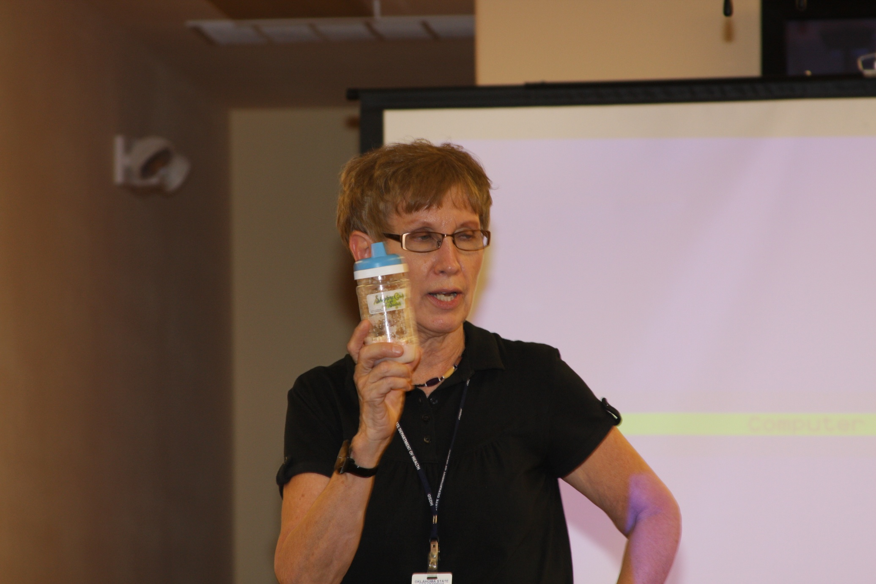
….and it rots your teeth.

Slide 15
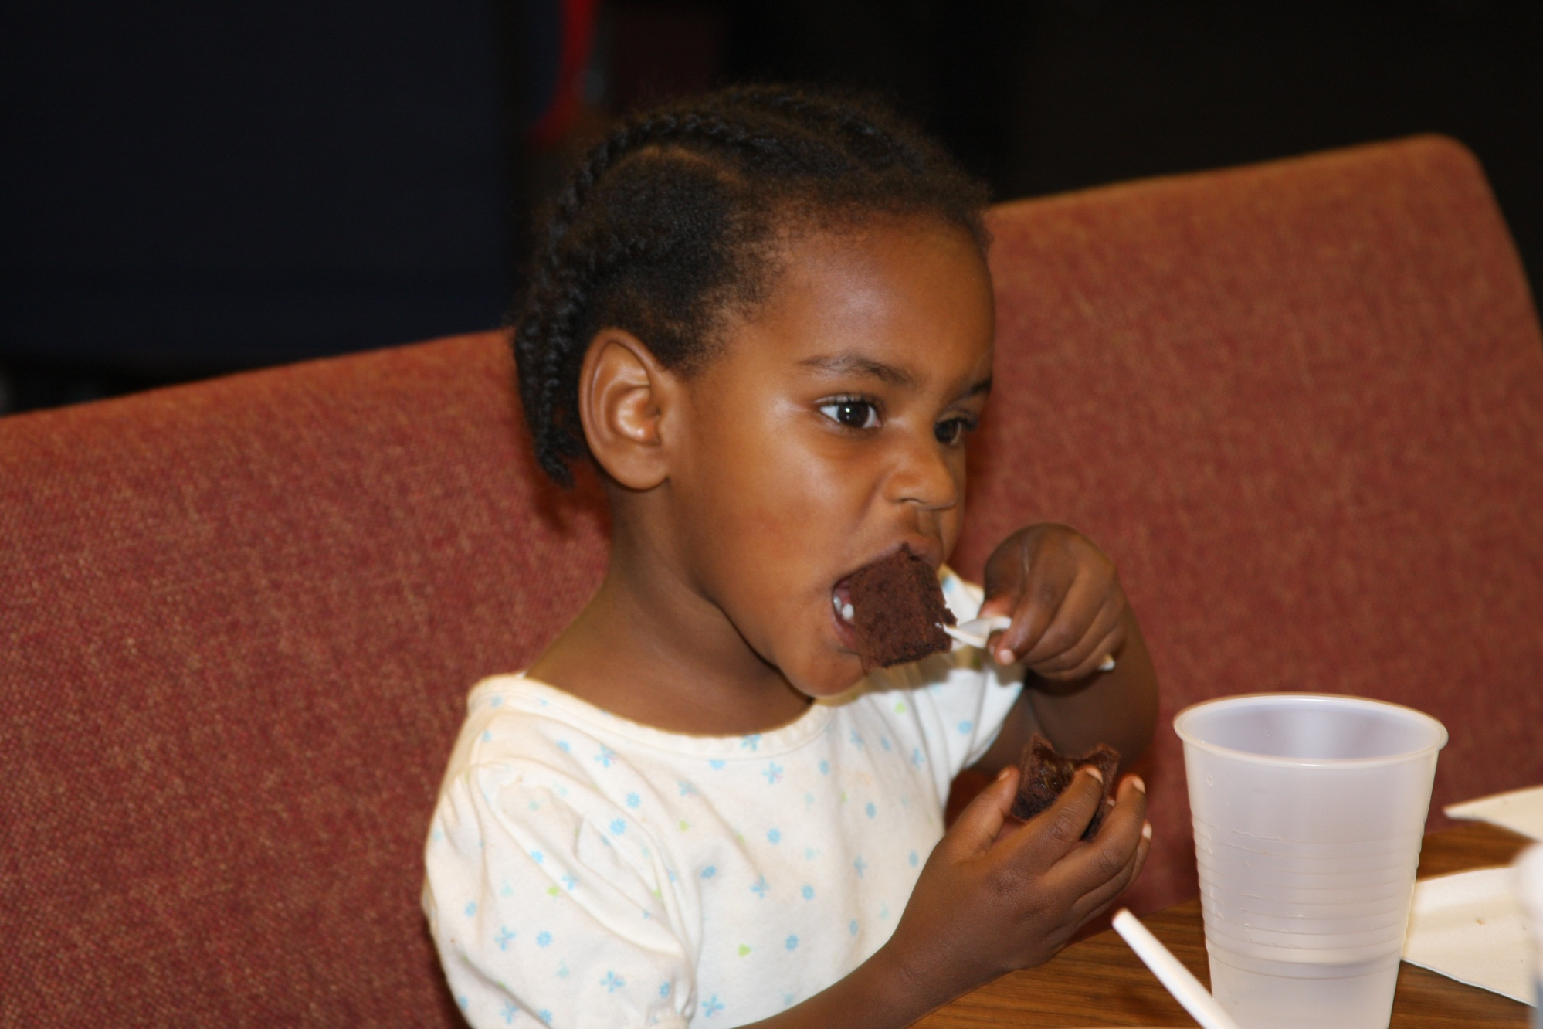
Eating the Black Bean Brownies

Slide 16
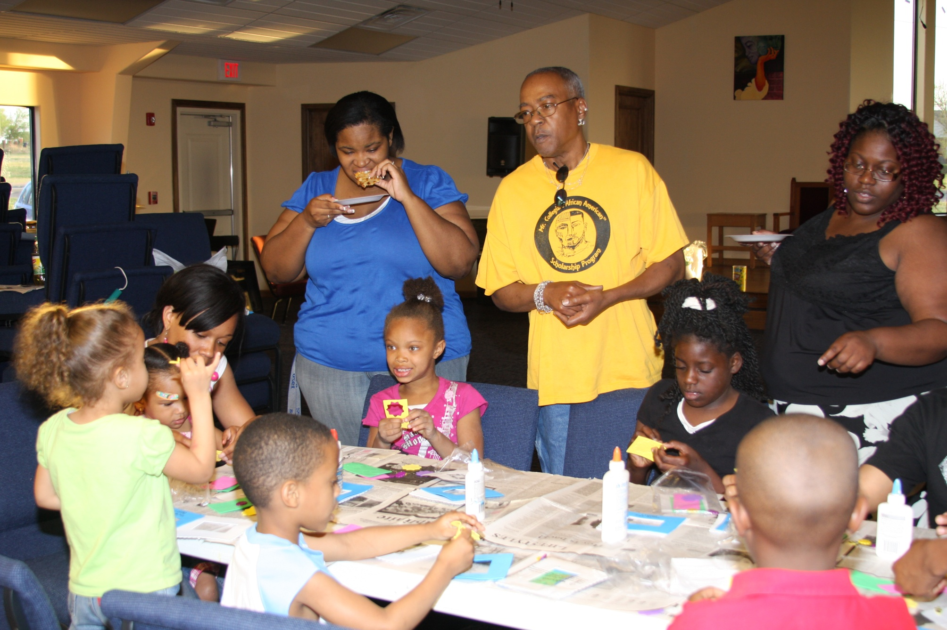
Making Mother’s Day Picture Frames

Slide 17
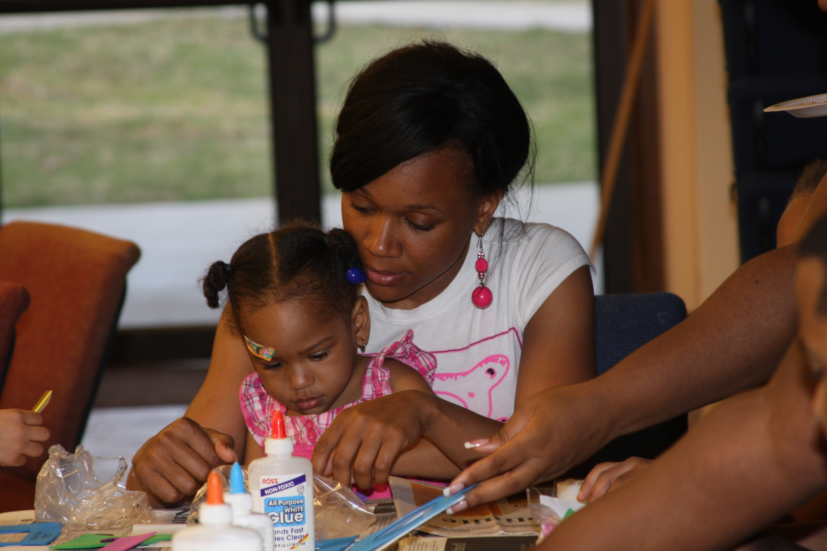
….with a little help from mom.

Slide 18
Week 3: Fitness
Dancing
The Wobble
Western Swing
African Dance Moves
RIF Book Distribution
Art Activities

Slide 19
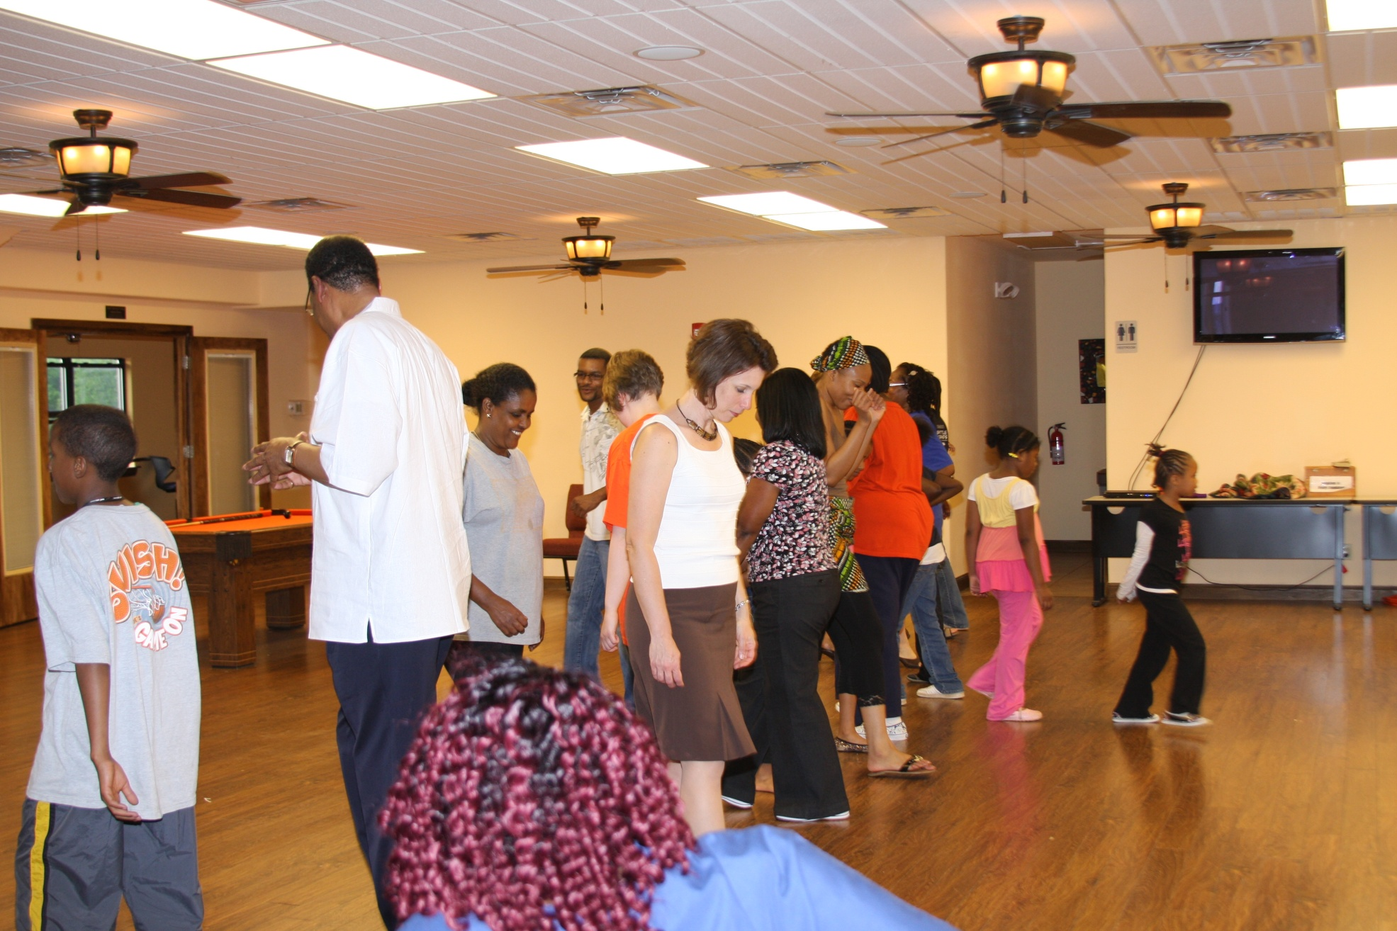
The Wobble

Slide 20
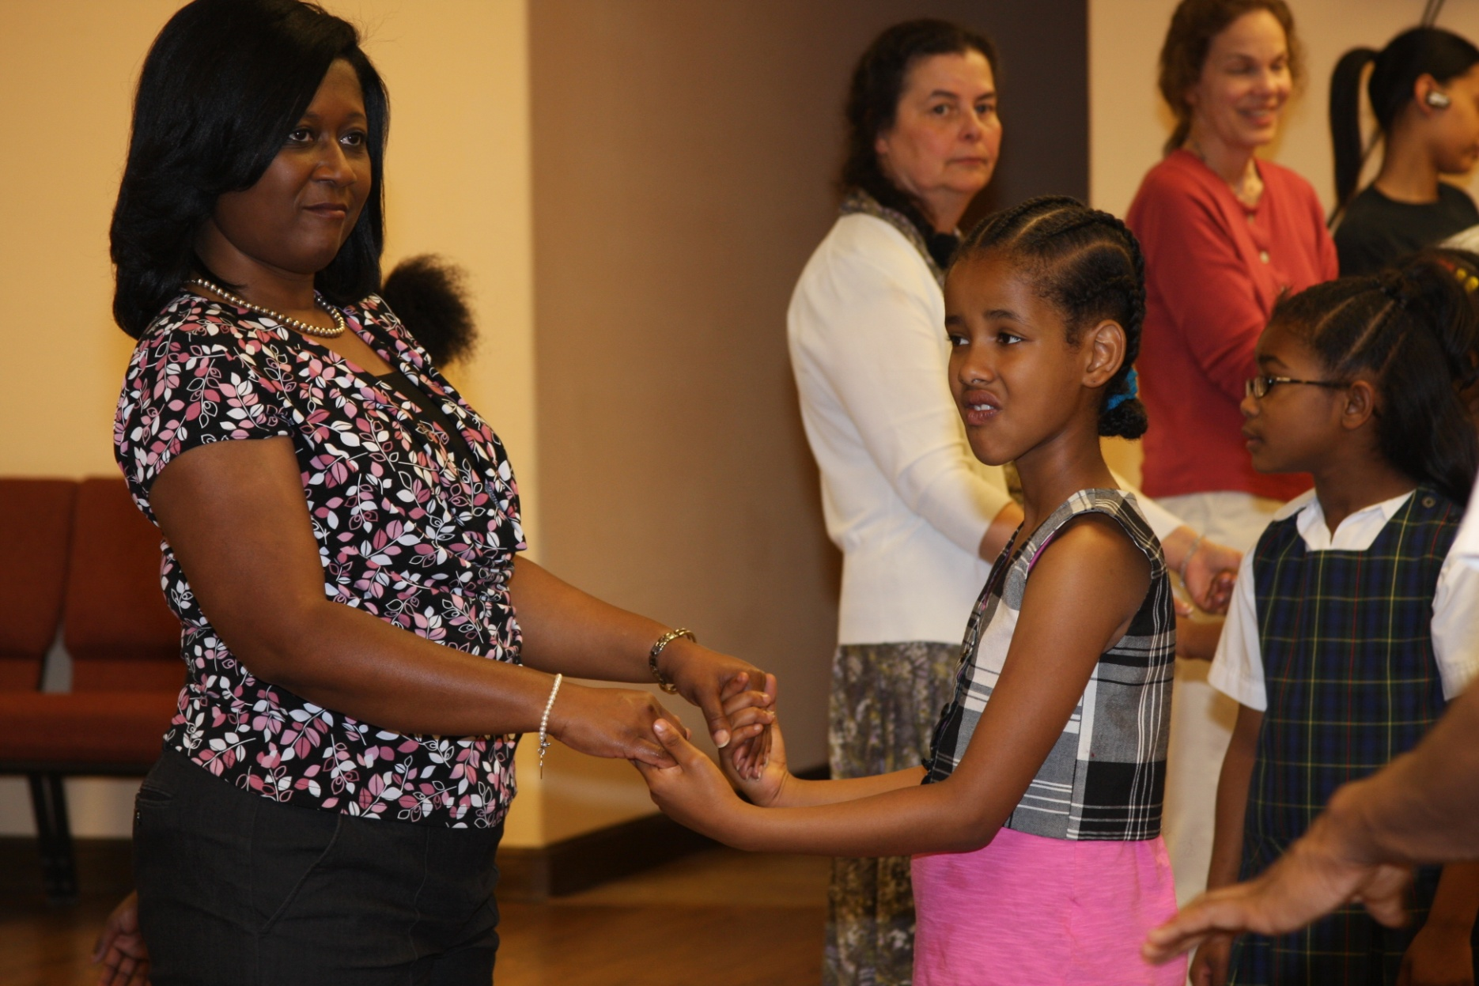
Western Swing

Slide 21
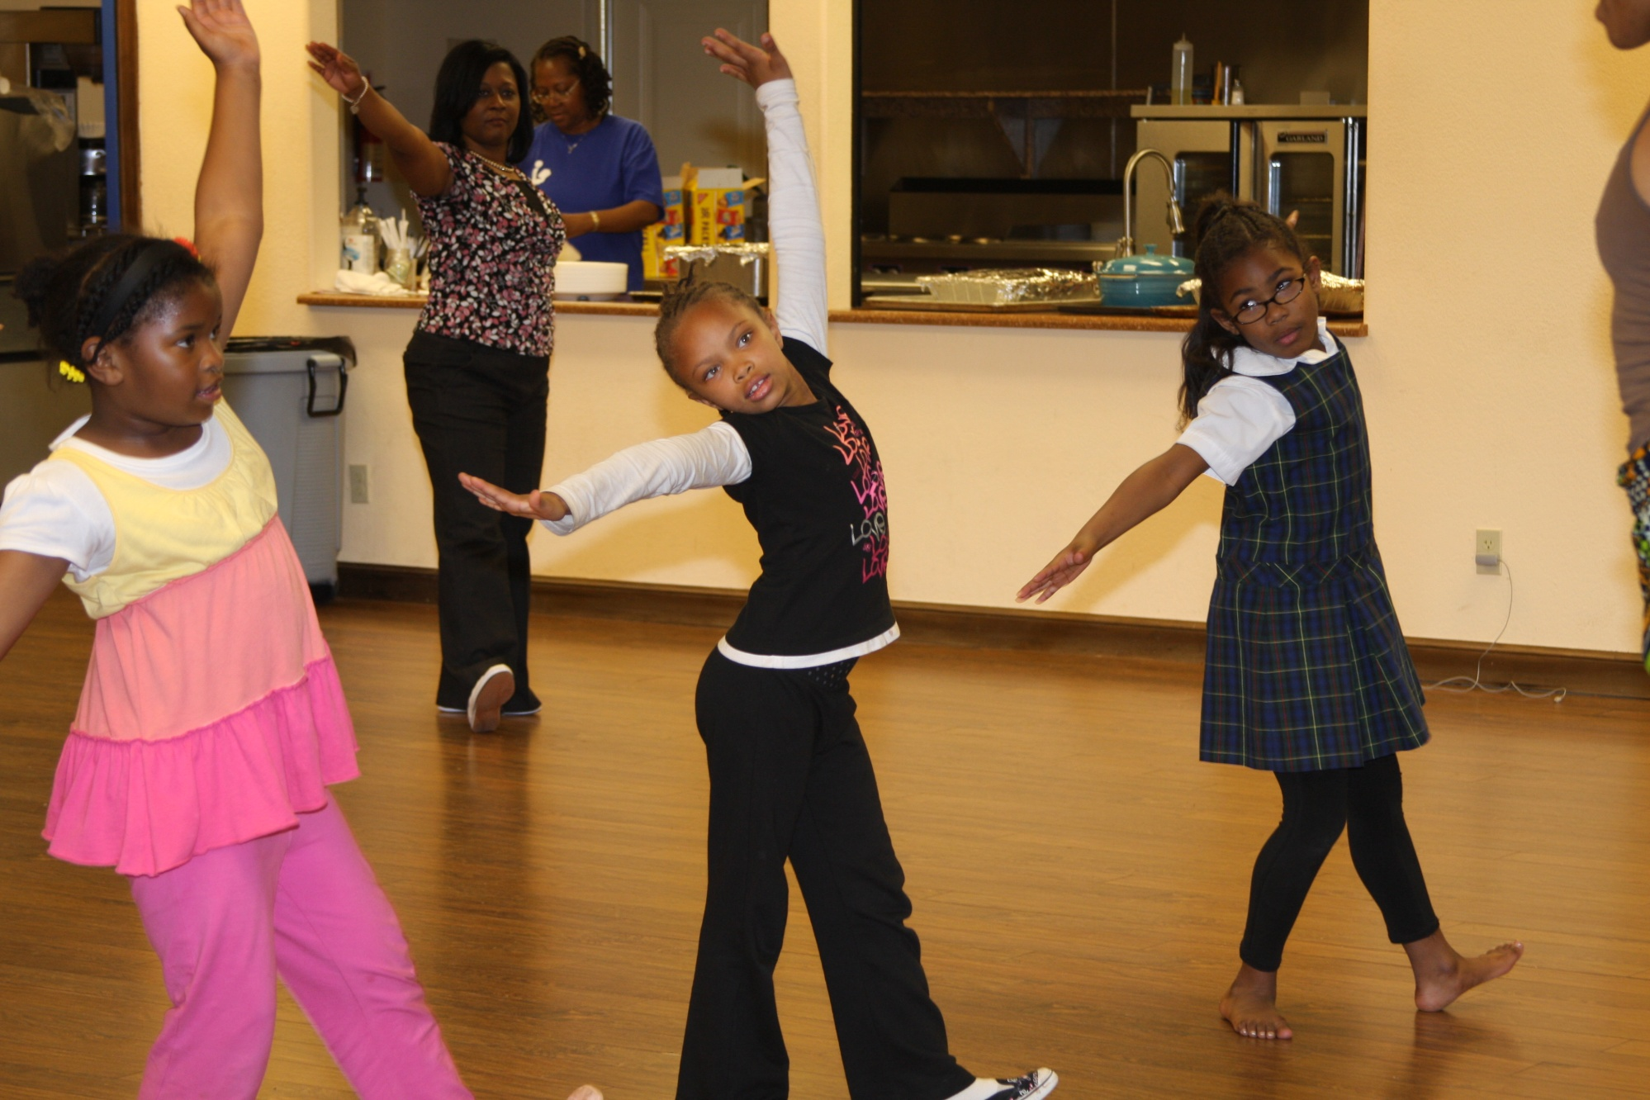
African Dance…move to the beat

Slide 22
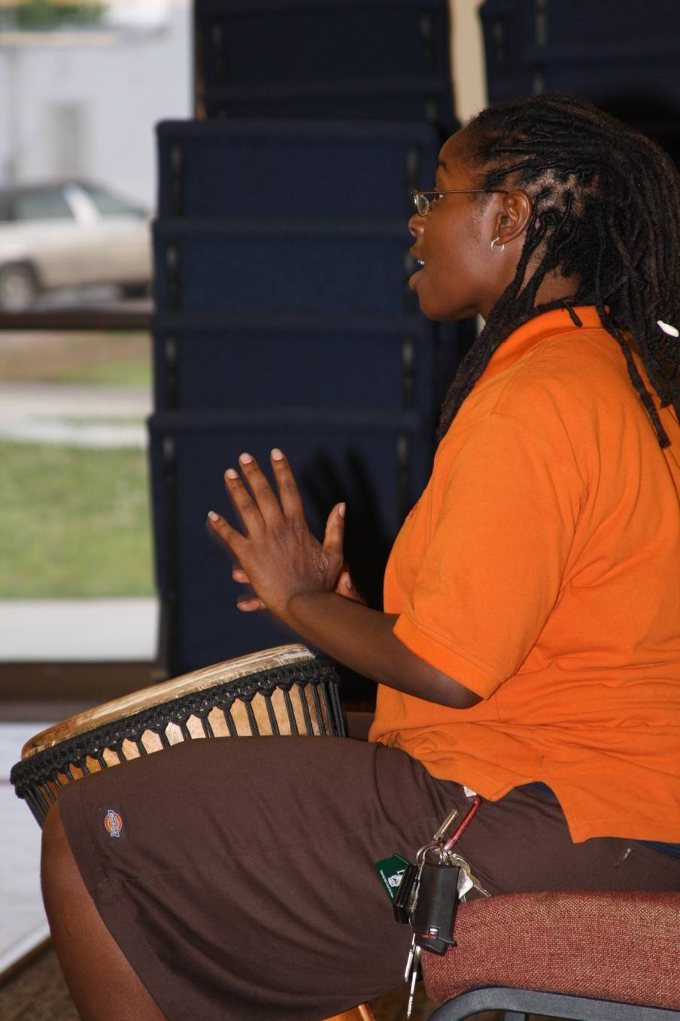
Of the Drum

Slide 23
Week 4: Celebrations
Sorority & Fraternity Cookout
Parachute Game
Outdoor Activities
RIF Book Distribution
Arts Activities

Slide 24
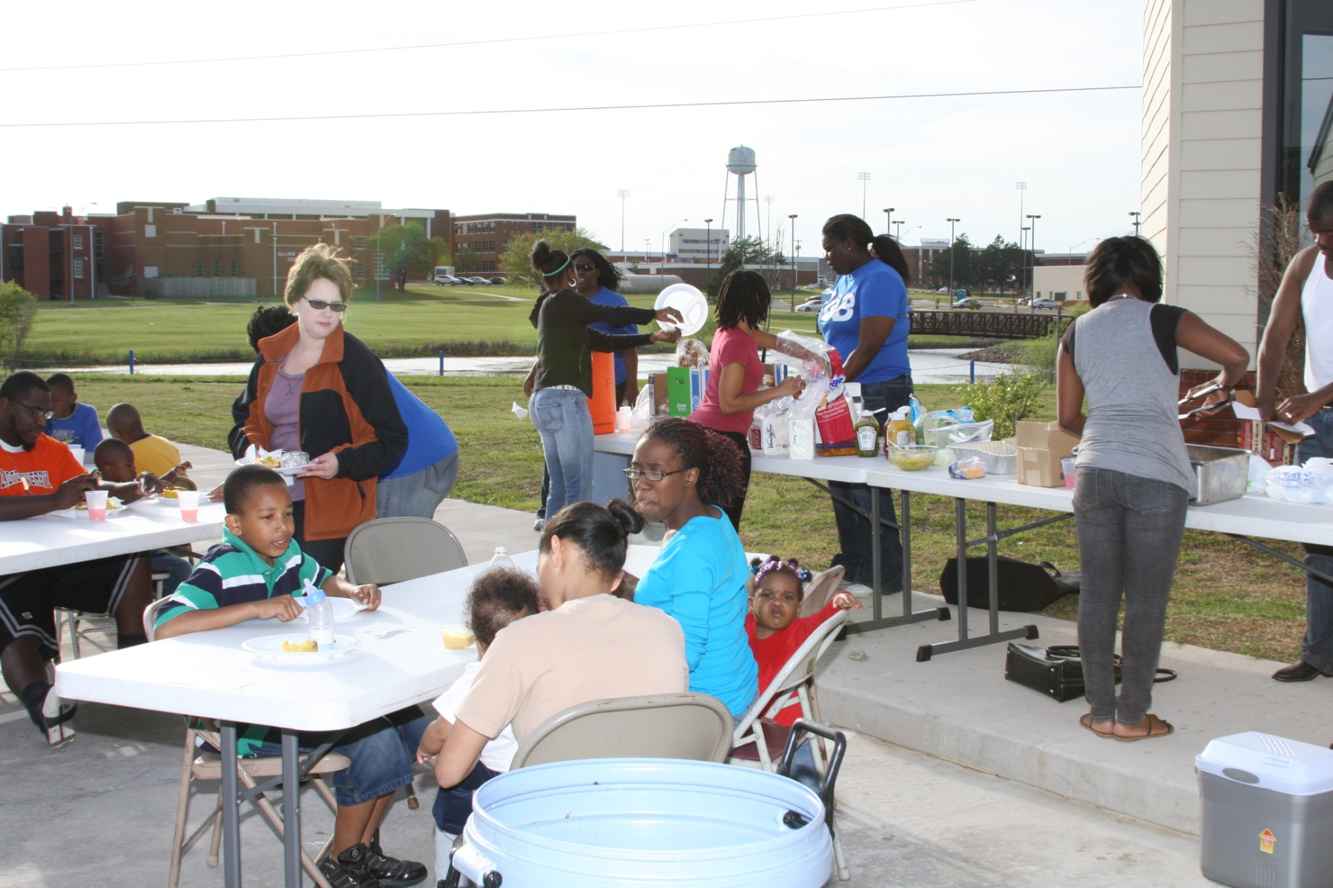
Preparing to Cookout

Slide 25
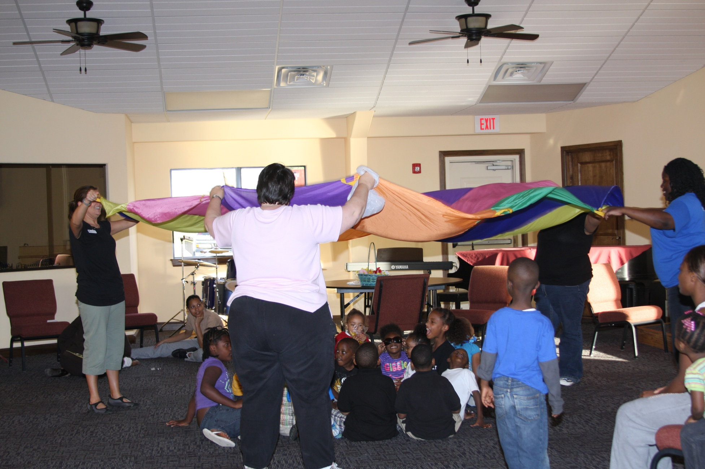
Under the Parachute

Slide 26
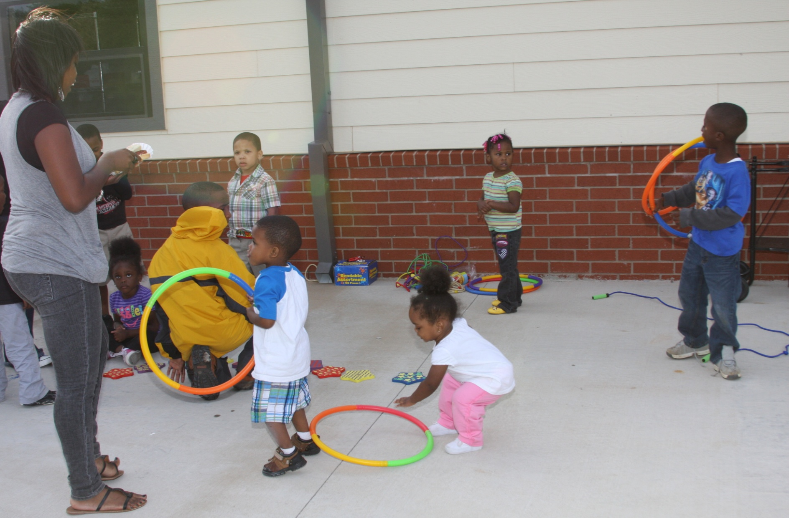
Hula hoops

Slide 27
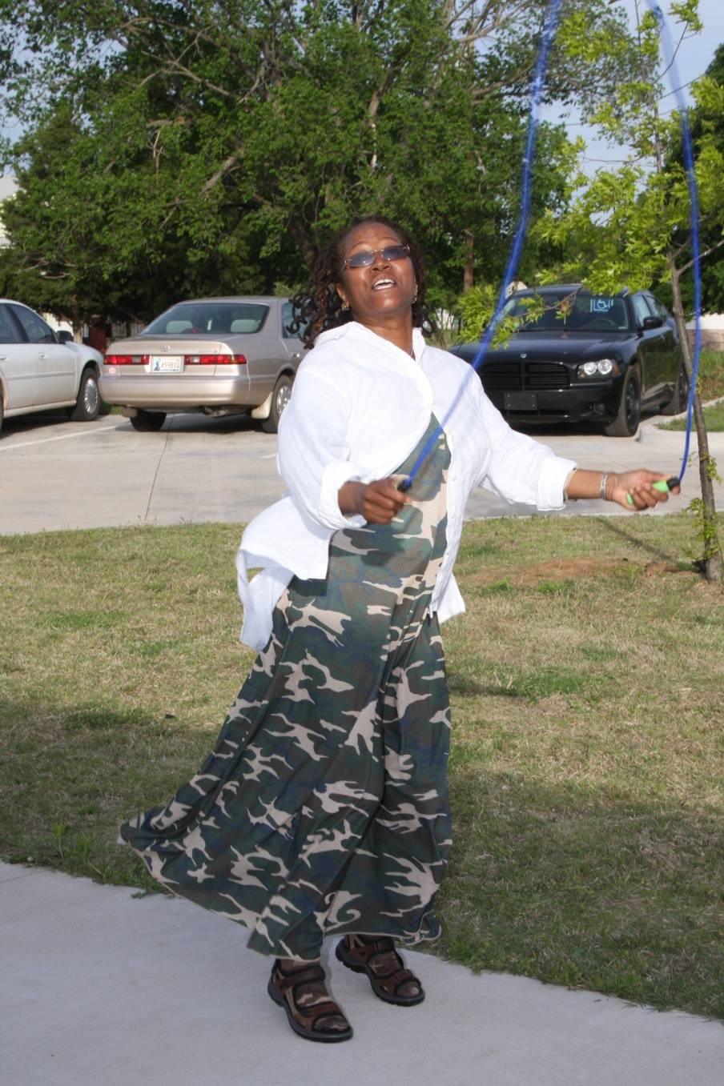
Jumping Rope

Slide 28
Project Review
Challenges
Recruitment, time management, organizing meals, finding a family friendly venue
Stakeholders, student parents, children, the University, contributors from the local community
Change Issues: Parenting habits, nutrition, and fitness behavior of student parents
Institute Resources Used: Stakeholder Analysis, Environmental Scan, and the Library’s Strategic Plan

Slide 29
Summary & Conclusion
Use the program for a model
Introduced more student families to the Library faculty & staff
Networked with faculty with other University departments & schools
Raised the Library profile within the University & the community

Slide 30
What We Learned
Read the fine print!
If at first you don’t succeed keep going!
Word of mouth works wonders.
Very labor intensive program.
Align actions with your strategic plan
Identify the stakeholders
Seek community support

