Slide 1
EXTREME MAKEOVER: Florida Memorial University Edition Gloria Oswald, Director Ana Guthrie, Reference Librarian

Slide 2
PROJECT OVERVIEW
Vision
INFORMATION LITERACY
To increase students’ ability to navigate academic research resources
To encourage students to maximize library databases and IT portals
To redirect students from requesting research to self-sufficiency
To engage students in the academic publishing world (i.e. publishing process, citations, best practices)

Slide 3
PROJECT OVERVIEW
Vision
PROGRAMMING
To provide stimulating, intellectual activities that complement FMU’s mission and curriculum
To promote “the life of the mind” or lifelong learning

Slide 4
PROJECT OVERVIEW
Vision
OUTREACH
To stimulate patrons to view the library as a new-age, information hub
To promote a “the life of the mind” or lifelong learning
To revamp the library as not just a book repository but a campus center

Slide 5
PROJECT TEAM:
Gloria Oswald, Director
Lucy Osemota, Head, Reference & Archives Services
Ana Guthrie, Reference Librarian
PROJECT STAKEHOLDERS:
FMU Faculty, Staff, Students, Family & Administration
PROJECT TOOLS/RESOURCES:
FMU Campus Lecture Classroom(s), Lou Rawls Center for Performing Arts, Library Facilities, IT Equipment & Online library and information platforms

Slide 6
application of knowledge
HBCU LIBRARY LEADERSHIP INSTITUTE CONFLICT RESOLUTION
EMOTIONAL INTELLIGENCE
BUDGET ALLOCATION
INFORMATION LITERACY CONFERENCE
SAVANNAH GA EDGY INITIATIVES
COST-EFFECTIVE METHODS
MODELS FROM OTHER HBCUs
i.e. JOHNSON C. SMITH

Slide 7
OUTCOMEs
One-on-One Faculty Information Literacy Sessions dubbed “Lunch& Learn”
DSR 099: Critical Thinking & Reading
Presented on library during the Faculty Meetings
Information Literacy Course Proposal
New Faculty Orientation Proposal
INFORMATION LITERACY

Slide 8
OUTCOMEs
PROGRAMMING
Librarians served on campus committees
Partnered with campus Black History Month Committee on campus-wide celebrations
Assisted with execution of flagship program: ASHE: Literature across the African Diaspora
Brought in author Marita Golden, who read on stage from her latest work
Golden also provided a 8-hour creative writing workshop for the campus
Marketed the library as much as possible

Slide 9
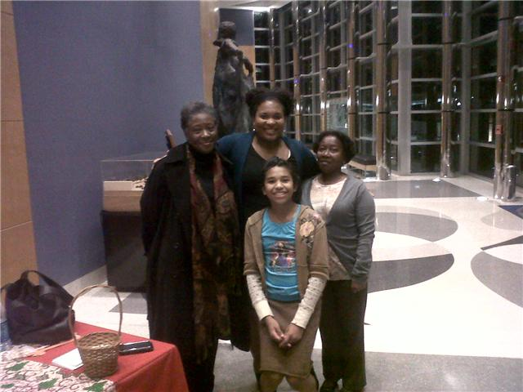
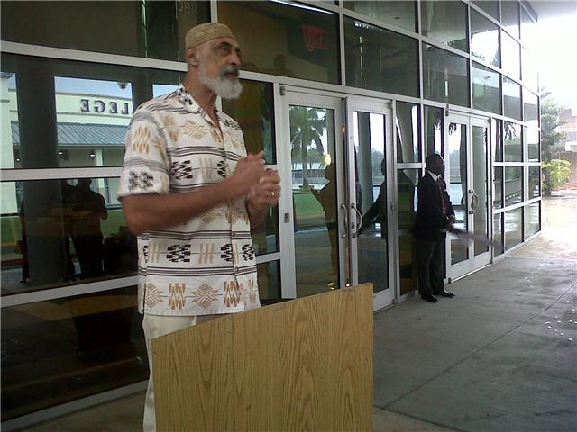

Slide 10
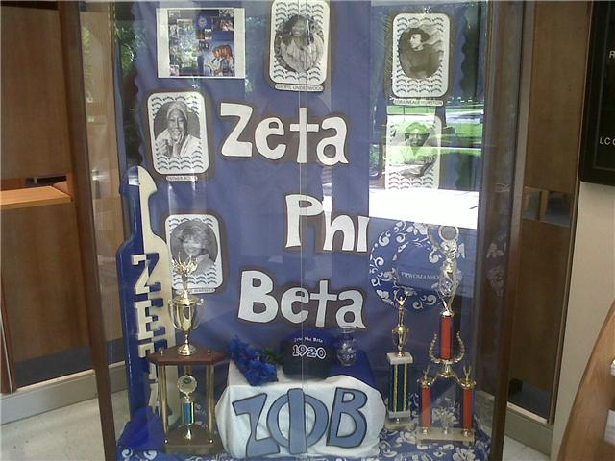
OUTCOMEs
OUTREACH
Outreach to Greeks
Library Café Renovation & Opening
Revising Policies

Slide 11
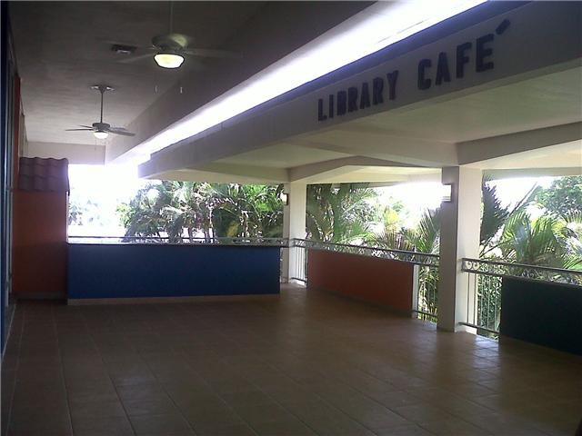
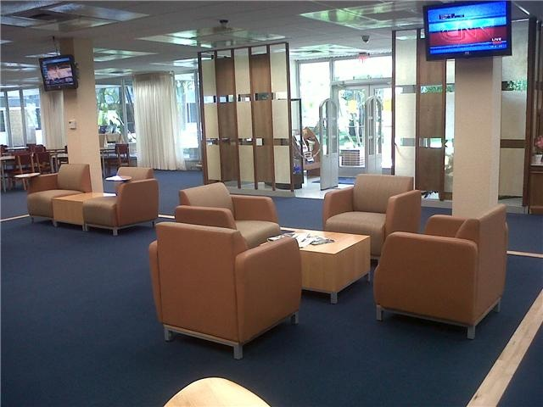

Slide 12
PROS
Creativity
Flexibility
Resources/Budget
Time Management
Campus Participation
CONS

Slide 13
QUESTIONS/
COMMENTS?

